Slide 1

The Asian, Australasian and Pacific Islands
Regional At-Large Organisation
Lianna Galstyan
APRALO Vice Chair
Kathmandu, Nepal 24 February, 2018

Slide 2

At-Large Community Organizational Structure
NARALO
23 ALSes in
3 out of 8 countries
EURALO
37 ALSes in
17 out of 78 countries
The five RALOs unite our ALSes based on their geographic regions, namely:
Africa (AFRALO)
Asia, Australasia and Pacific Islands (APRALO)
Europe (EURALO)
Latin America and the Caribbean Islands (LACRALO)
North America (NARALO)
APRALO
53 ALSes in 30 out of 74 countries and 9 Individual Members
LACRALO
54 ALSes in
21 out of 33 countries
AFRALO
50 ALSes in
30 out of 55 countries
At-Large Advisory Committee (ALAC) - 15 Members
10 selected by RALOs to serve on the ALAC
(2 from each RALO)
Seat #15 on the ICANN Board is selected by the ALAC and the
At-Large Community
5 selected by Nom Com to serve on the ALAC
(1 from each region)

Slide 3
APRALO’s Core Values
COLLABORATION
APRALO has MoUs with partners such as DotAsia, APTLD and APNIC
to promote and facilitate engagement and training activities within APAC region.
DIVERSITY
APRALO covers a vast geographic region and encompasses a diversity of cultures, languages and scripts, presenting exciting challenges.

Slide 4
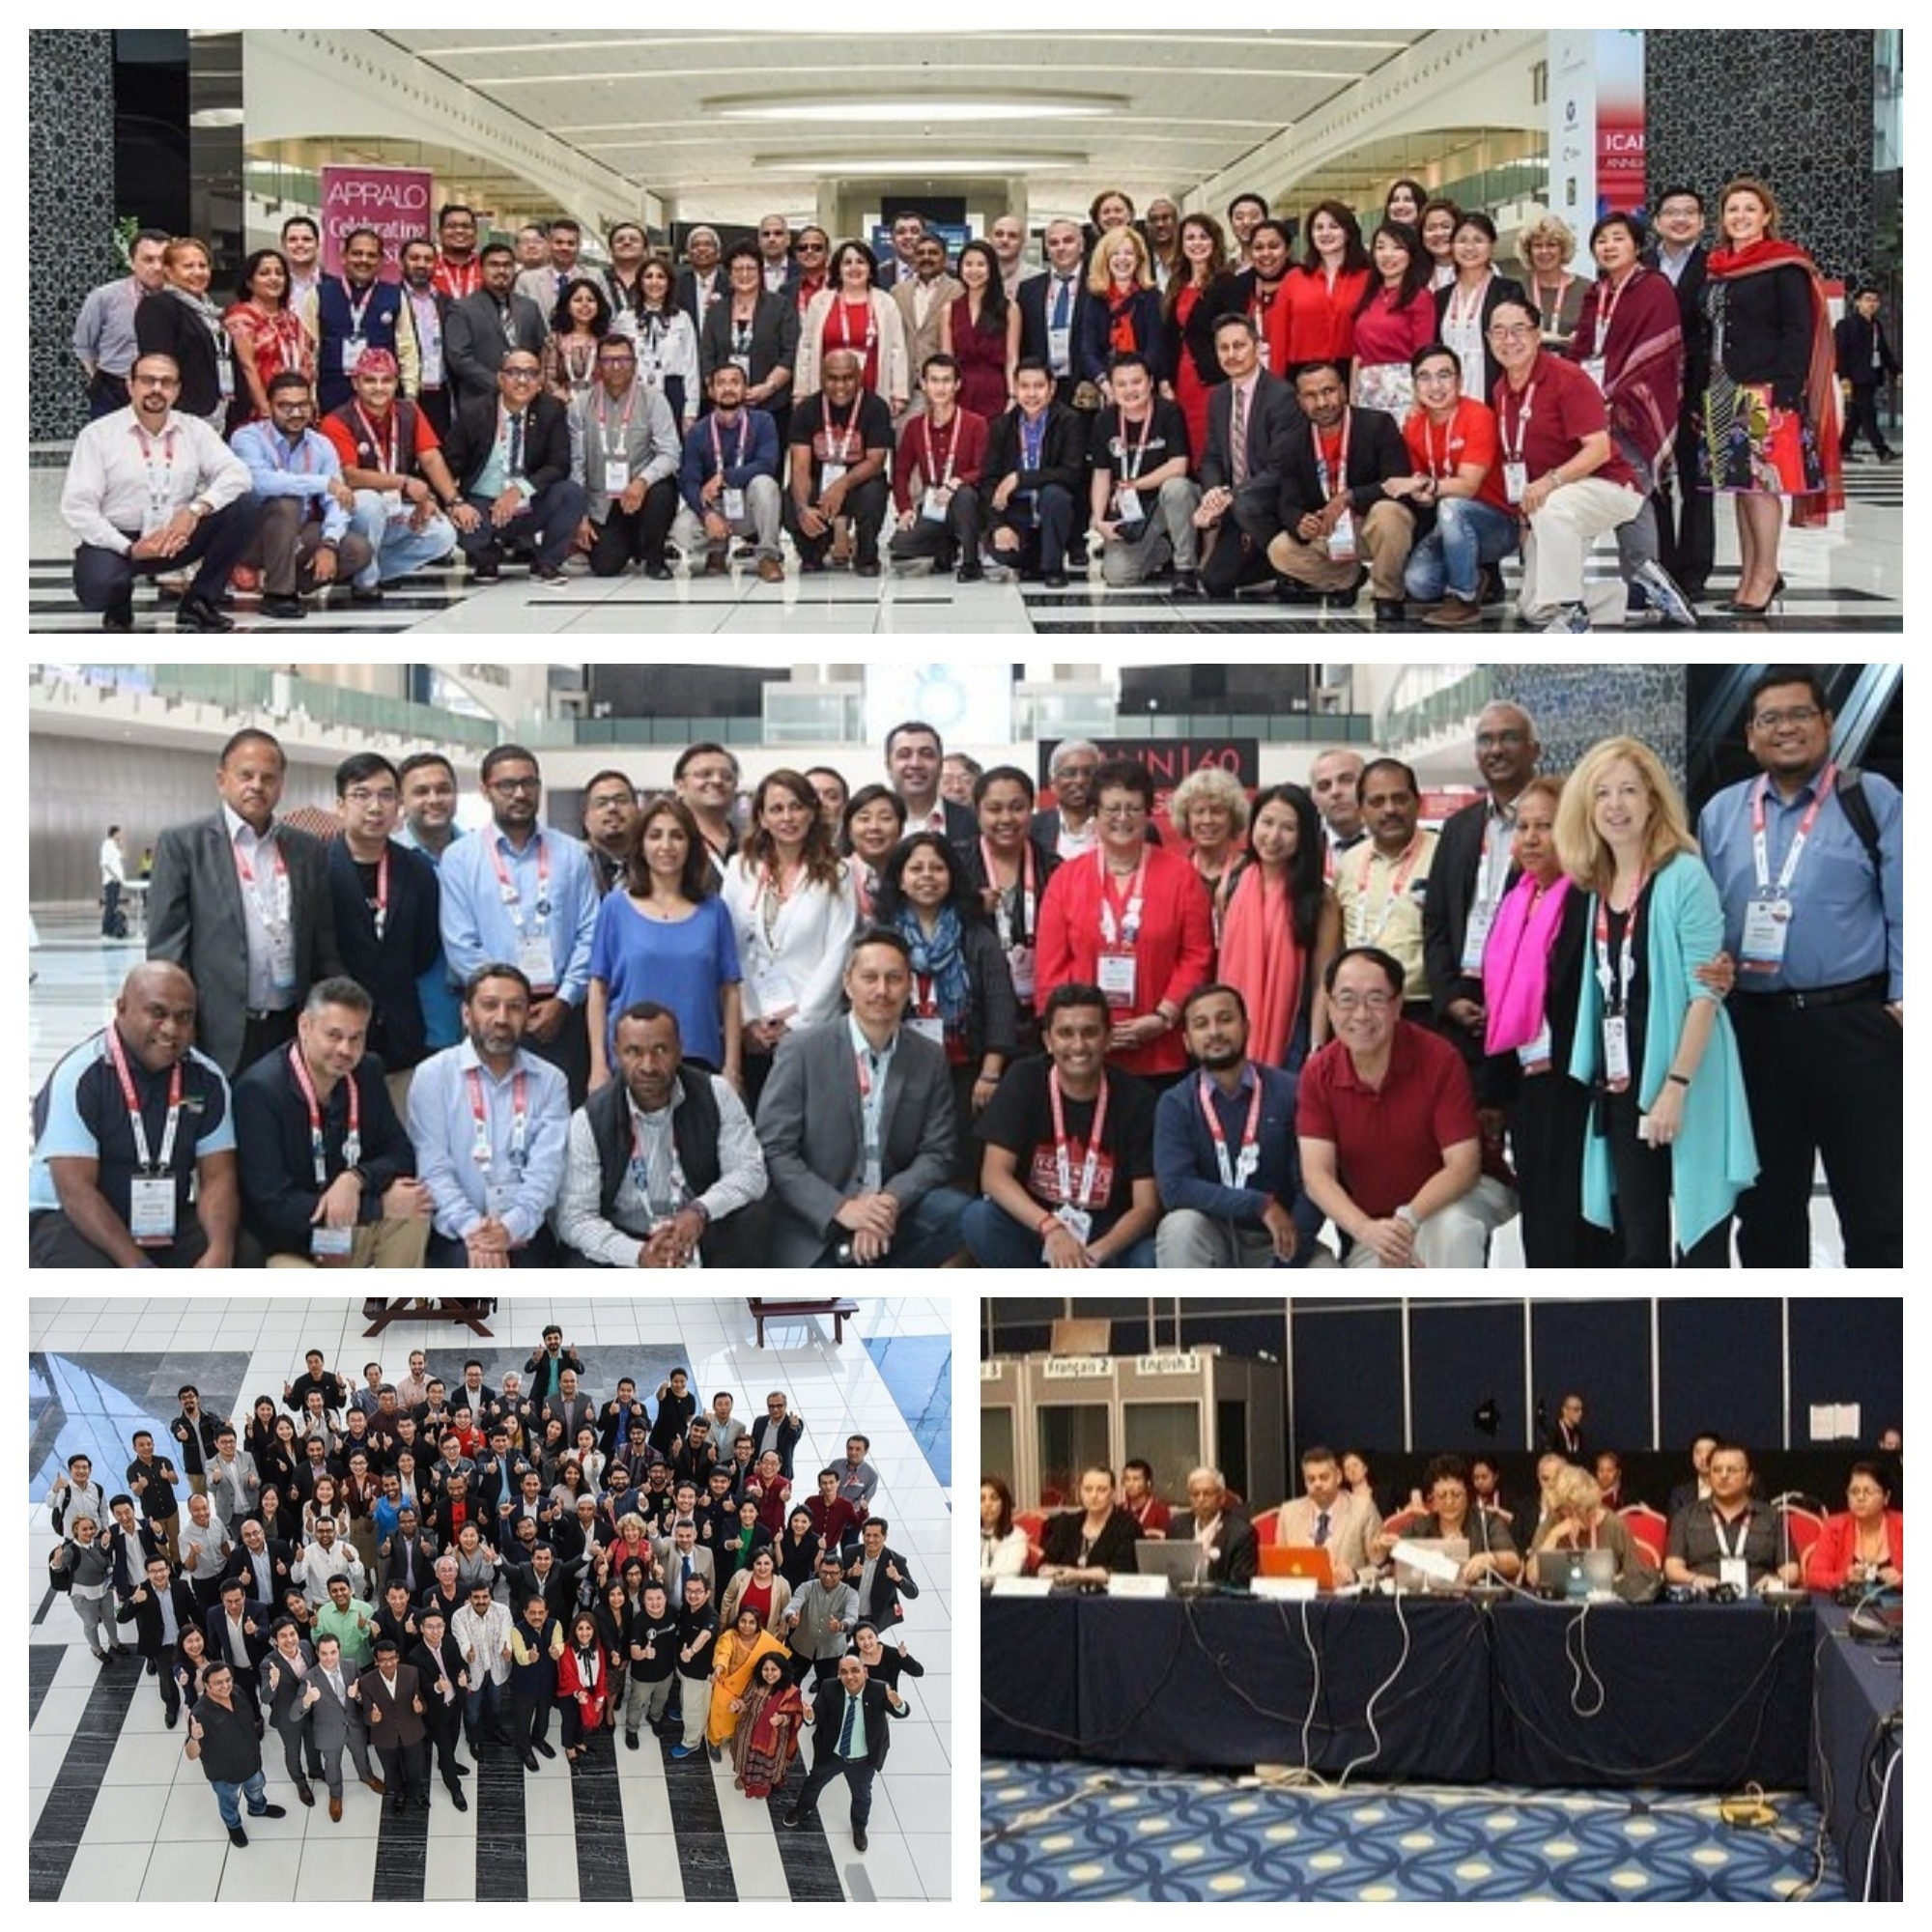
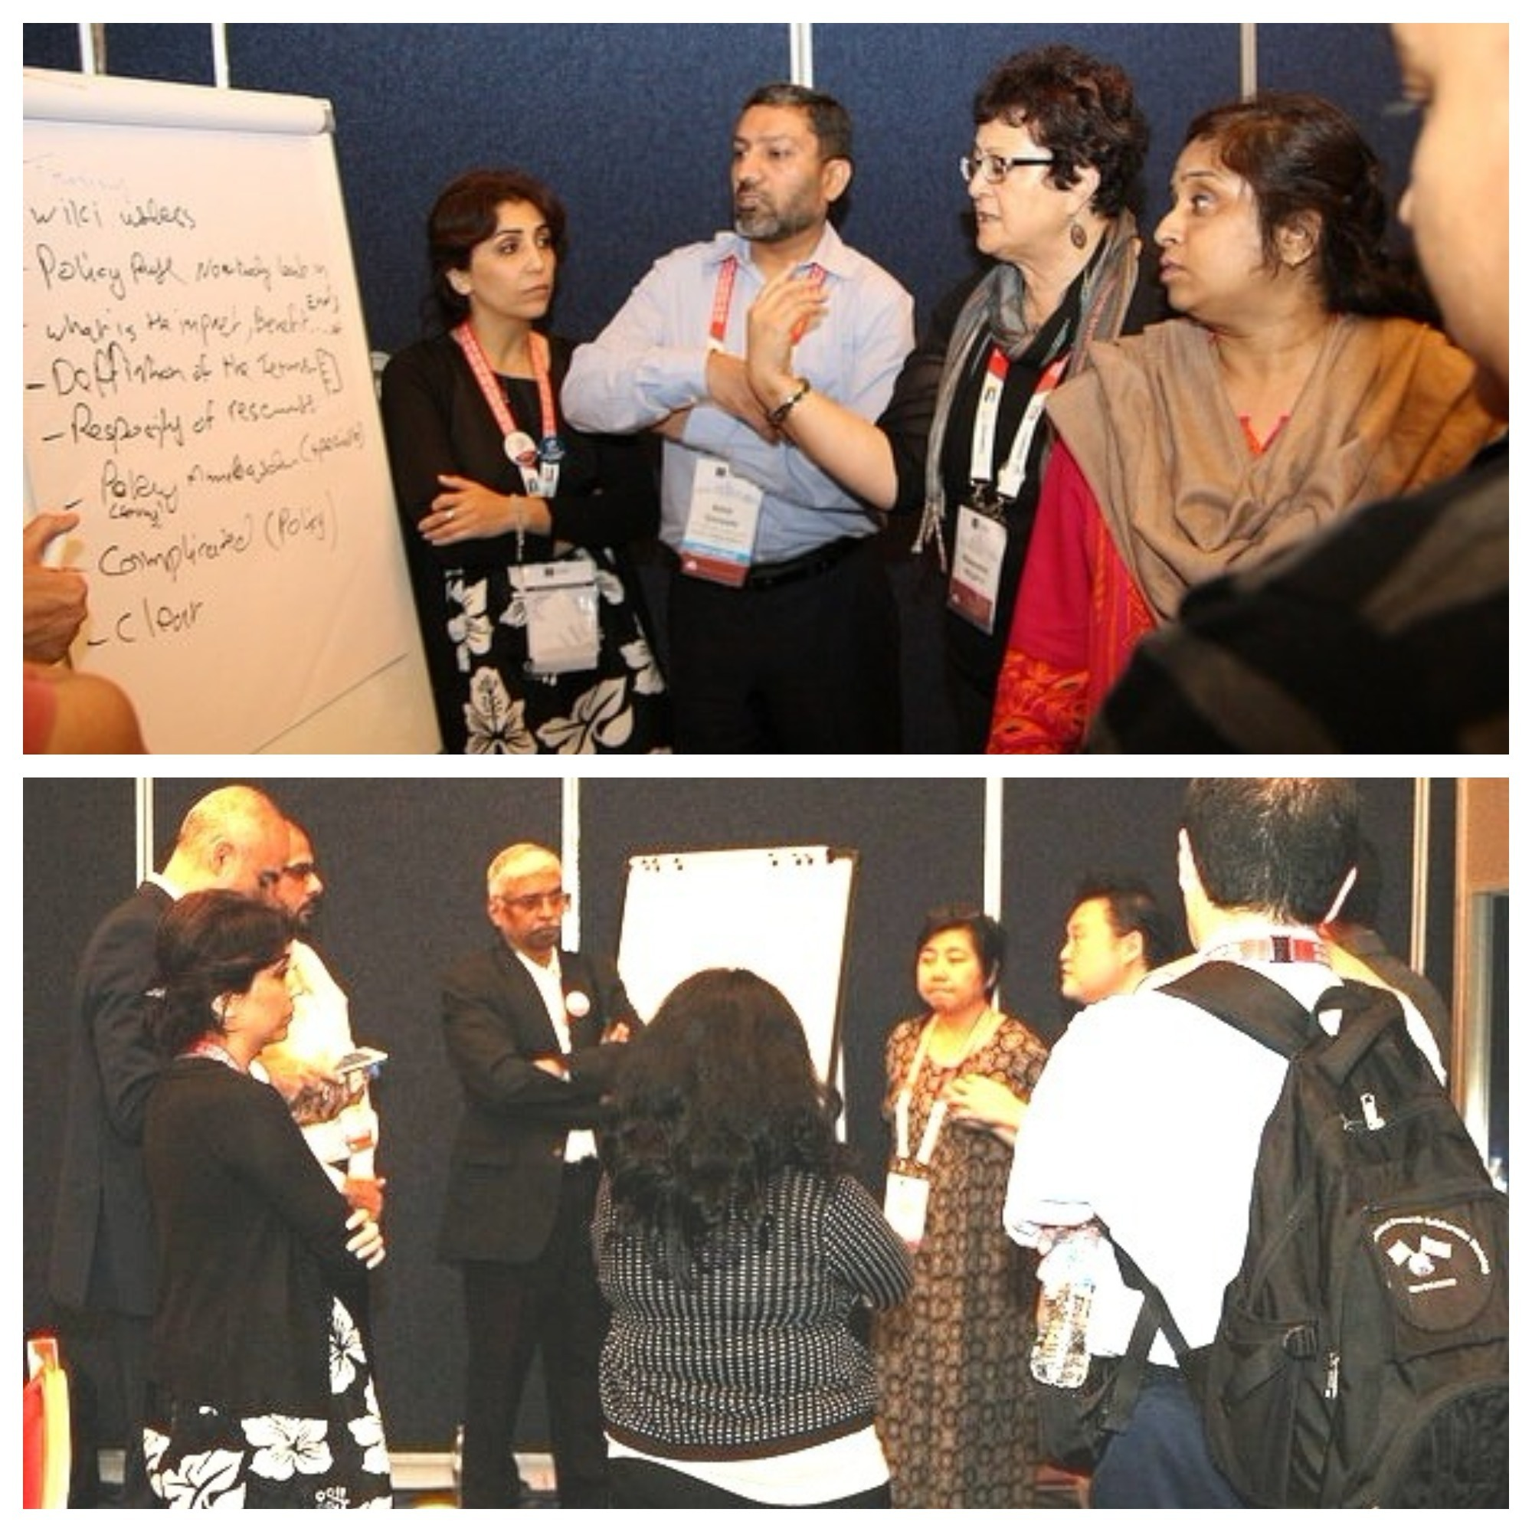
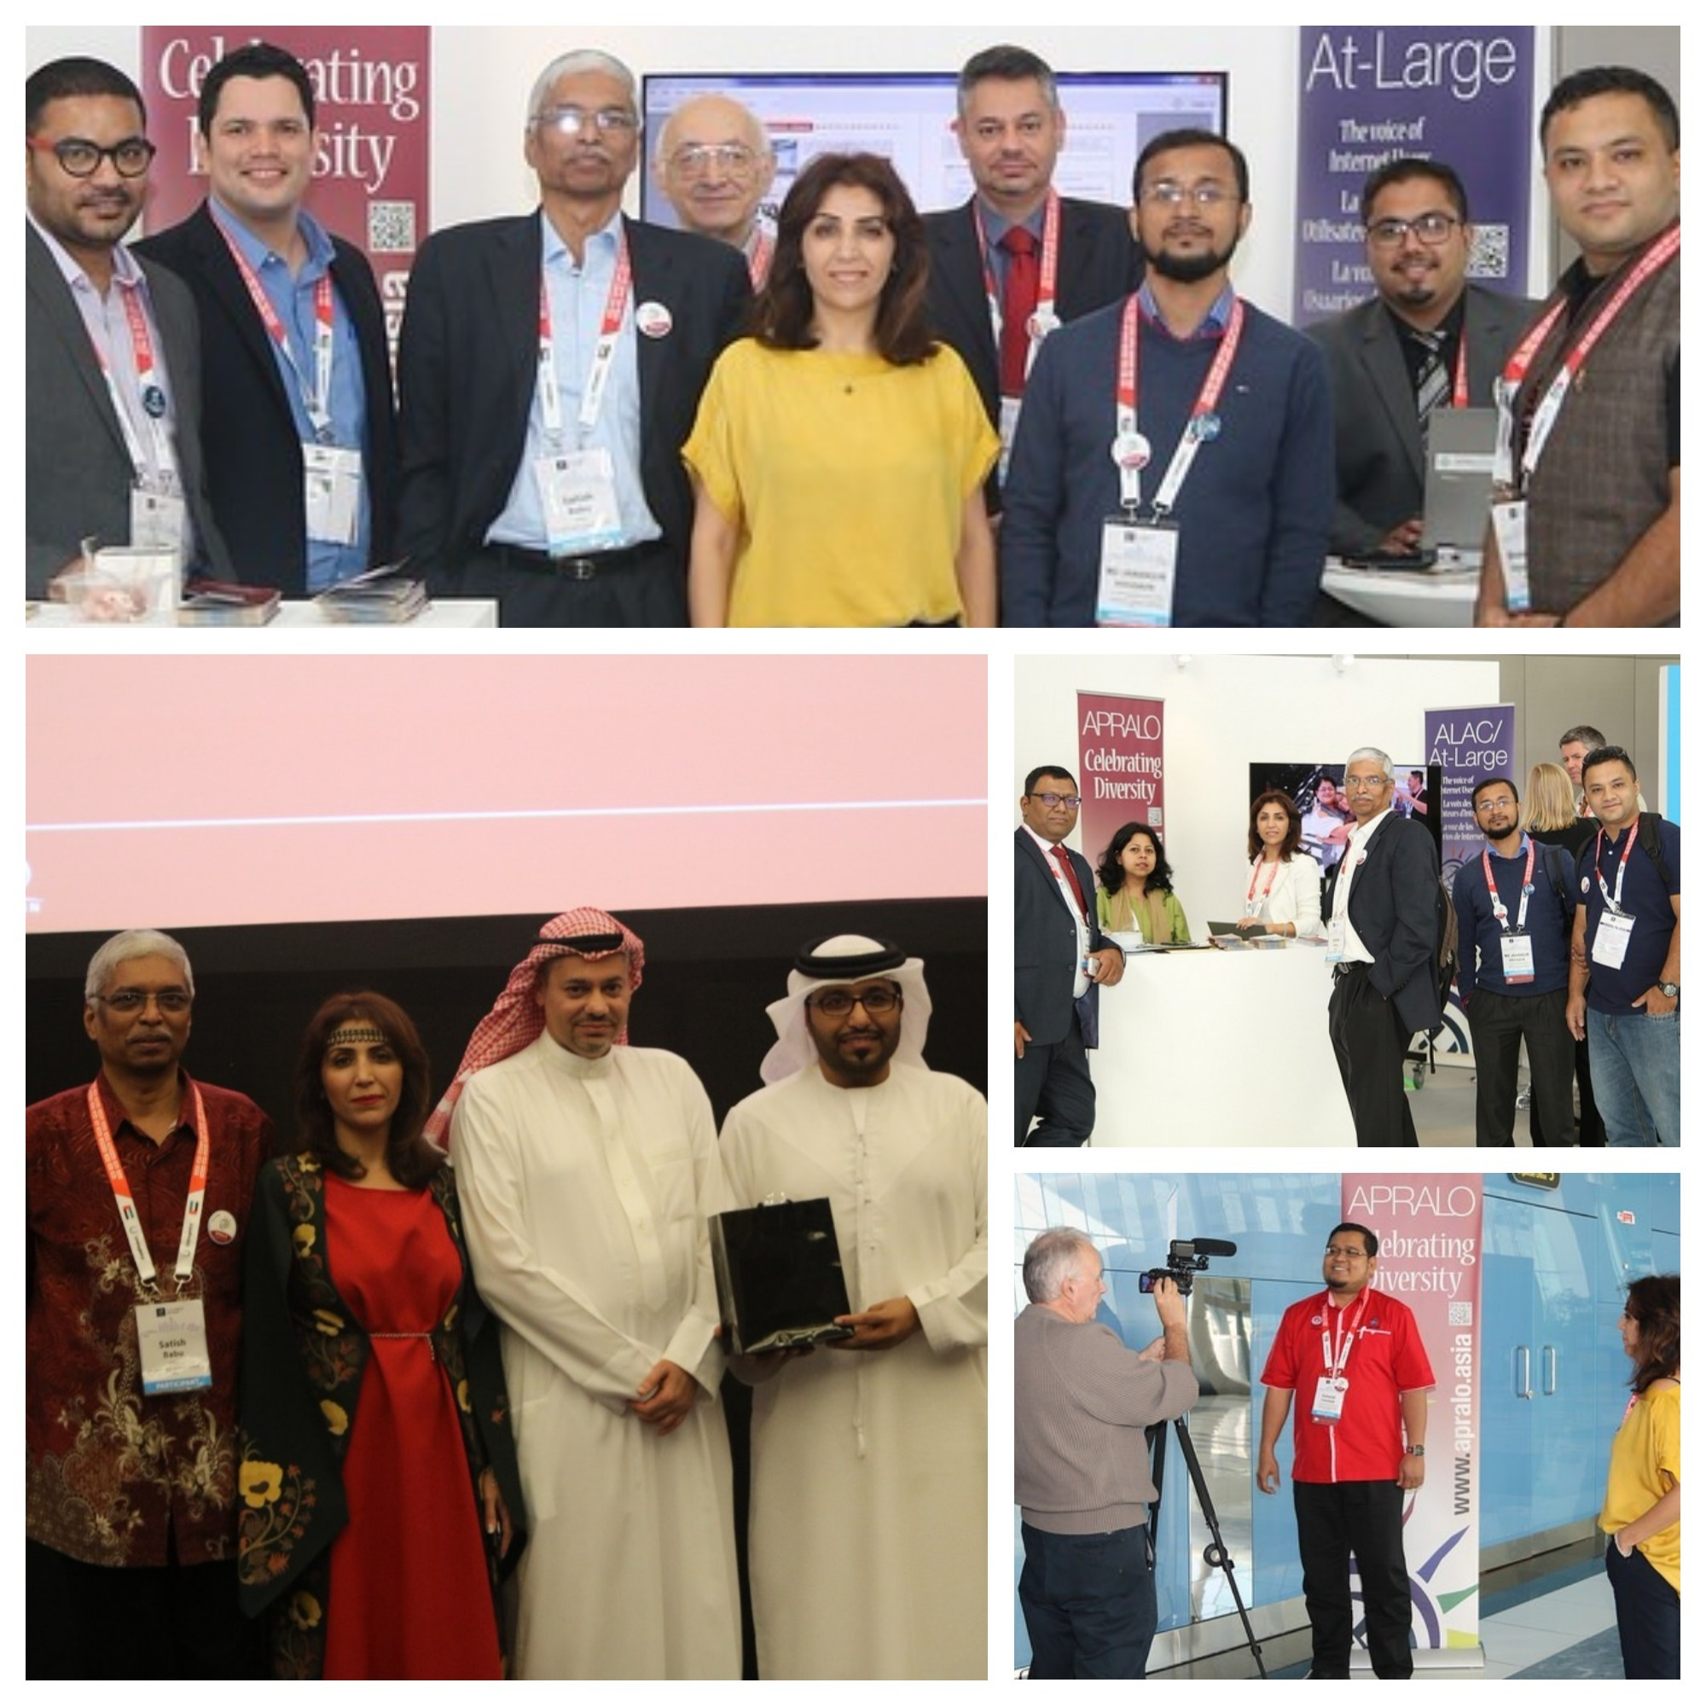
General Assembly @ICANN60 in Abu Dhabi, UAE

Slide 5
Policy Hot Topics
Technical Topics
Security & Stability: Threats and Responses
The Dark Web
DNS Security and Abuse
Current Security Trends Impacting Registrants and End Users
IDNs and Universal Acceptance
Basic DNS and DNS Ecosystems
Policy Areas
ICANN Public Interest Commitments
Reserved Names
Privacy
WHOIS and GDPR
Geographical Names
Competition, Consumer Trust and Consumer Choice
Internet Governance
The Internet Governance Ecosystem
Internet Architecture

Slide 6
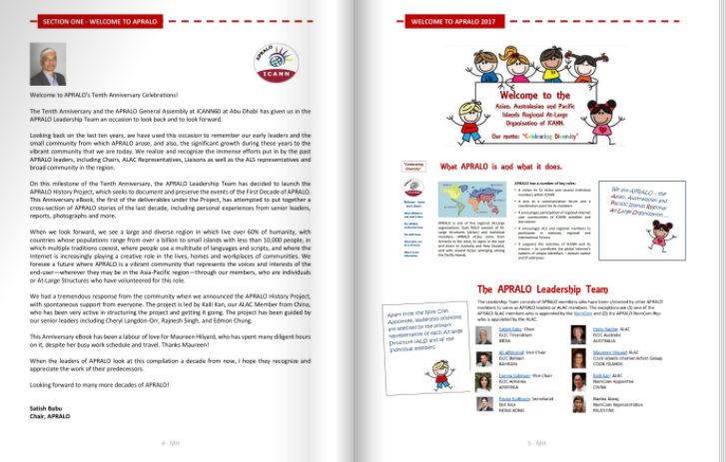
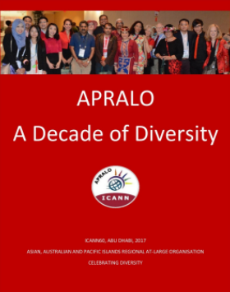
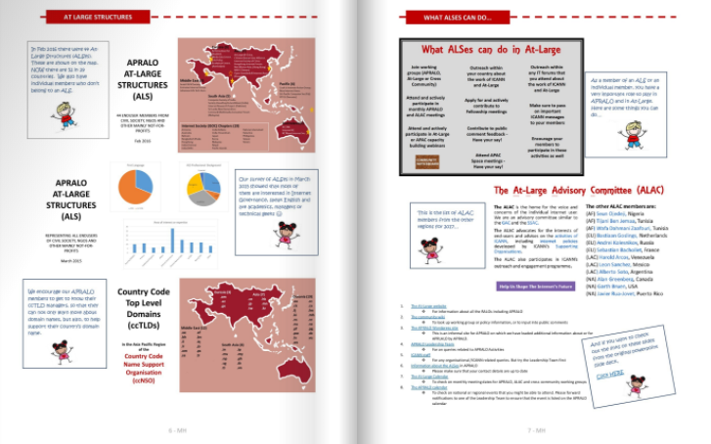
APRALO eBook

Slide 7
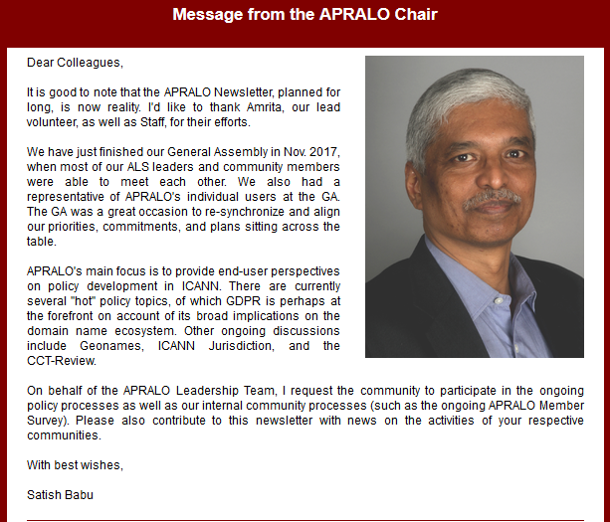
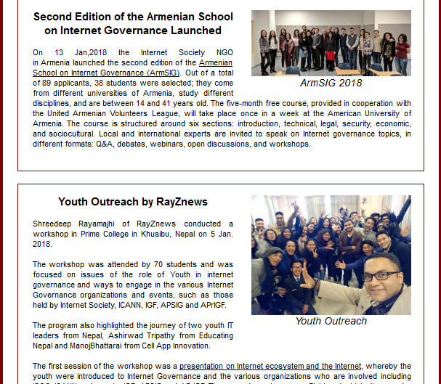
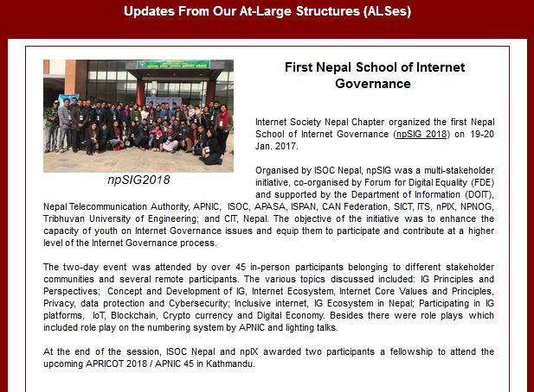
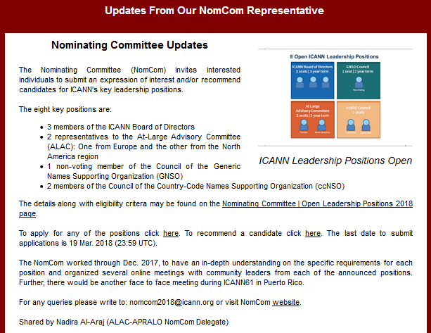
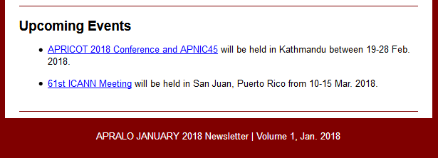
Monthly Newsletter launched in January 2018
ICANN Updates
  At-Large Highlights
  APRALO Highlights
Updates from our ALSes
  npSIG
  ArmSIG
  Youth Outreach by RayZNews
Updates from NomCom
Upcoming Events

Slide 8
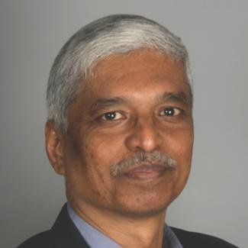
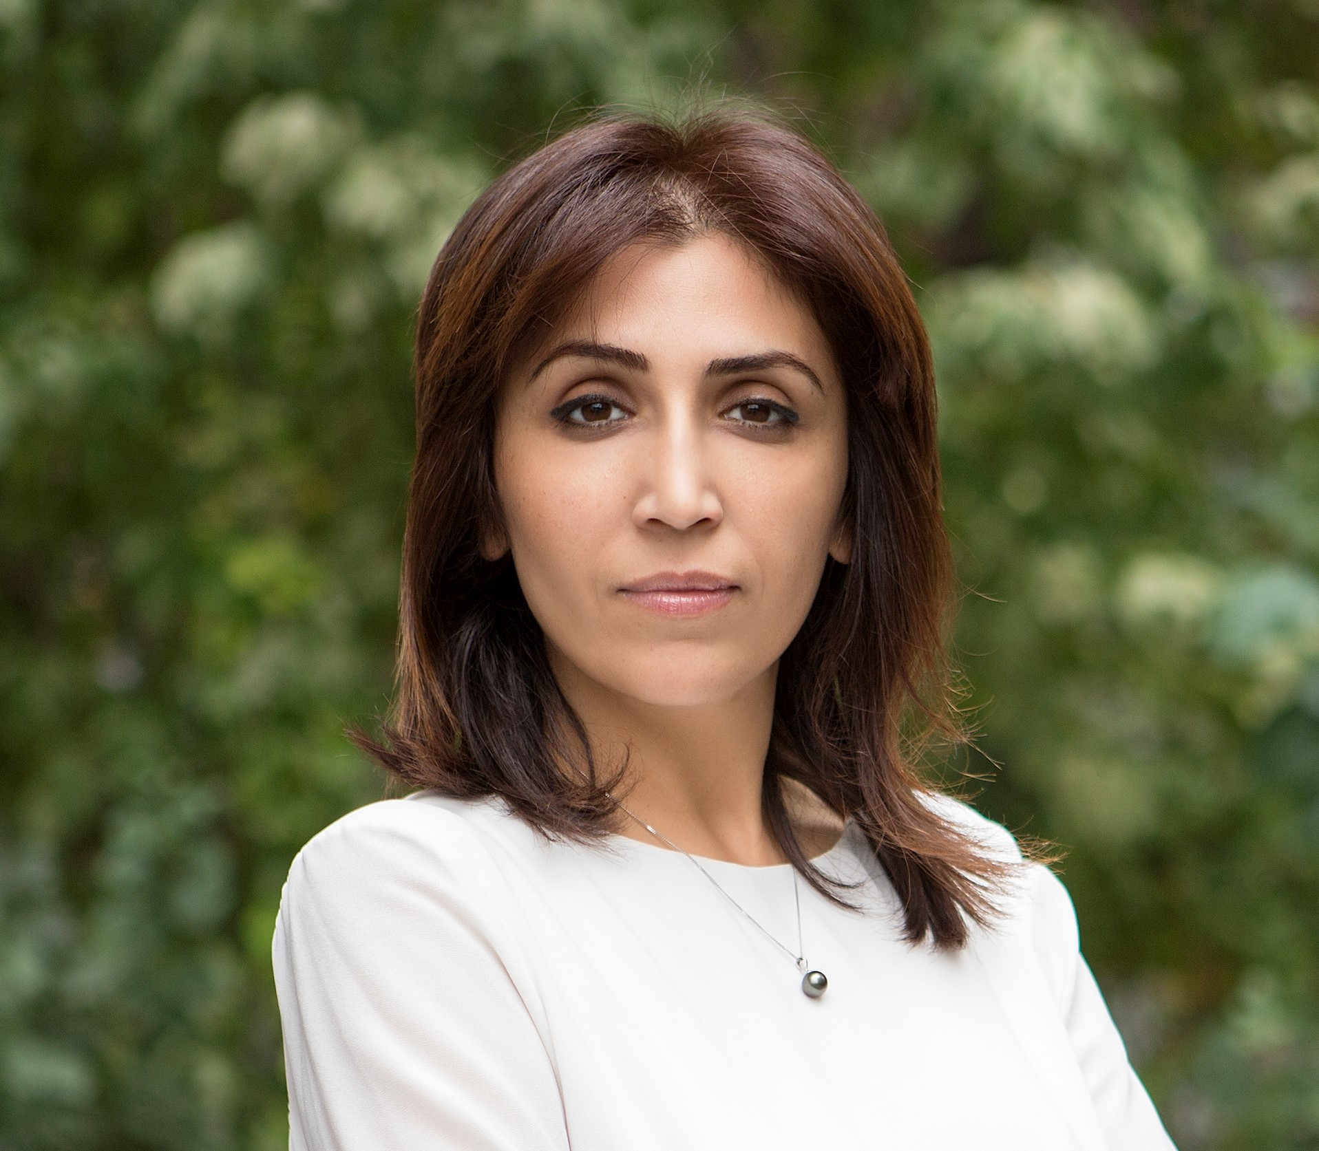
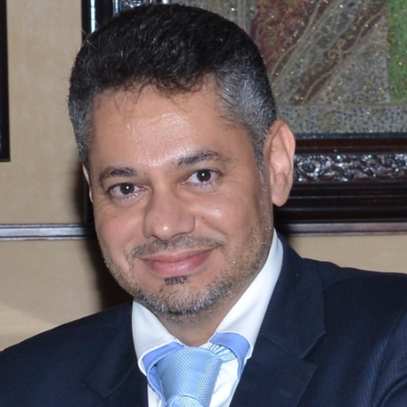

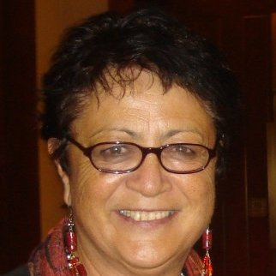

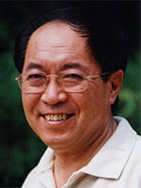
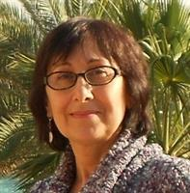
APRALO Leadership
Satish Babu, Chair
India
Lianna Galstyan, VC
Armenia
Ali AlMeshal, VC
Bahrain
Pavan Budhrani,
Secretariat, HK
ALAC Members
NomCom
Delegate
Maureen Hilyard
Cook Islands
Holly Raiche
Australia
Kaili Kan
China
Nadira Alaraj
Palestine

Slide 9





THANK YOU!
Social Media
(@icannatlarge, /icannatlarge )
At-Large Calendar
https://atlarge.icann.org/calendar
At-Large Mailing Lists
https://atlarge.icann.org/get-involved/mailing-lists
APRALO
The Asian, Australasian and Pacific Islands Regional At-Large Organisation
CELEBRATING DIVERSITY

