Slide 1
APNIC Foundation Update
AP* Meeting
APRICOT 2018
APNIC 45
Duncan Macintosh
Foundation CEO

Slide 2
Foundation update
Recent Progress
Projects
Board
Strategy and Activities

Slide 3
The APNIC Foundation
Incorporated in September 2016
Bank accounts operational in December 2016
First grants in July 2017
Operational budget for 2017-18 approved by EC
Two staff positions (CEO and Head of Programs) operational in January/May 2017

Slide 4
Foundation update 2
EC led board selection underway (up to 7 members)
Social media and website: https://apnic.foundation/
Projects underway

Slide 5
DFAT grant 2017-18-19
Funding source: Australian Department of Foreign Affairs and Trade’s (DFAT) Cyber cooperation program to build capacity in the Indo-Pacific - raising cybersecurity capability and awareness
Proposal: A secure and resilient internet infrastructure for development in the Pacific.
Amount: AUD 200,000 over two years (2017-19)
Economies: Cook Islands, Fiji, Kiribati, Marshall Islands, Papua New Guinea, Samoa, Solomon Islands, Tonga, Tuvalu and Vanuatu

Slide 6
DFAT grant cont.
CERTs established* or proposed: Fiji, Papua New Guinea*, Samoa, Vanuatu* and Tonga*
Activities: Community engagement, training workshops, technical assistance, fellowships, mentoring, seed funding

Slide 7
Board appointments
China: Edward Tian
India: Sharad Sanghi
Indonesia: Sylvia Sumarlin
First Board meeting in Hong Kong May 17th

Slide 8
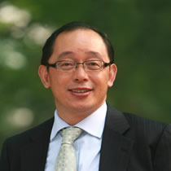
Foundation Board
Mr. Edward Tian (China)
Edward was the co-founder and CEO of AsiaInfo Holding Inc., the first Internet technology provider in China. He was also the vice chairman of PCCW Limited from 2005 to 2007. Also founder and chairman of China Broadband Capital Partners, a private equity fund that invests primarily in companies in the telecom, Internet, broadband, media and technology sectors in China. Before Edward founded CBC, he was the vice chairman and CEO of China Netcom Group from Nov. 2002 to May 2006. He was the CEO of China Netcom Company Ltd. from Aug. 1999 to May 2002.

Slide 9
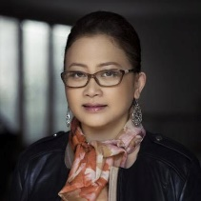
Foundation Board
Sylvia Sumarlin (Indonesia)
Sylvia is general chairman of Federasi Teknologi Informasi Indonesia (Indonesian Information Technology Federation) a professional organisation for IT companies in Indonesia. She previously served as the President of Dyviacom Intrabumi, one of Indonesia’s first ISPs which she founded in 1995.

Slide 10
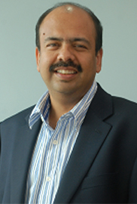
Foundation Board
Sharad Sanghi (India)
Sharad is the Managing Director and CEO of Netmagic, which he founded in July 1998, and is now an NTT Communications Company. He is responsible for growing Netmagic into India’s leading managed hosting and cloud service provider, with over 1100 employees and 9 data centres delivering services to over 2000 enterprise customers across the globe. Sharad is a pioneer in the Indian cloud computing space, and his vision has helped Netmagic become a leader in the public cloud services market in India.

Slide 12
Thank you

