Slide 1
APNIC Update
APstar Retreat
24 February 2018
Kathmandu, Nepal

Slide 2
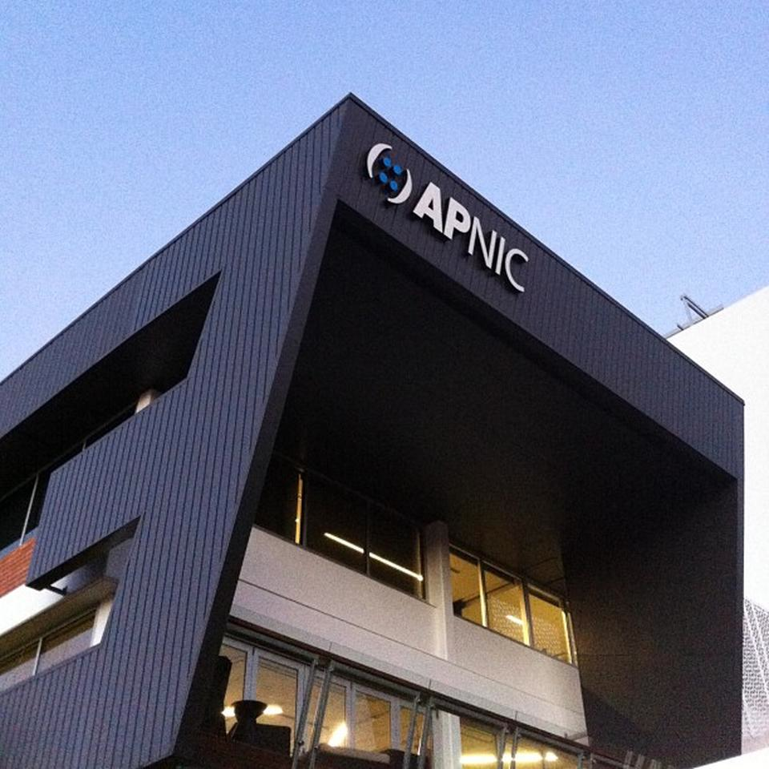
APNIC Vision
“A global, open, stable and secure Internet that serves the entire Asia Pacific community”
Notes:
I want to start by sharing with you about the APNIC vision. Since the beginning, APNIC has had a core mission which is narrow, but always with a purpose, which is big.

Slide 3
Activities
Serving APNIC Members
Supporting Regional Internet Development
Cooperating with the Global Internet Community

Slide 4
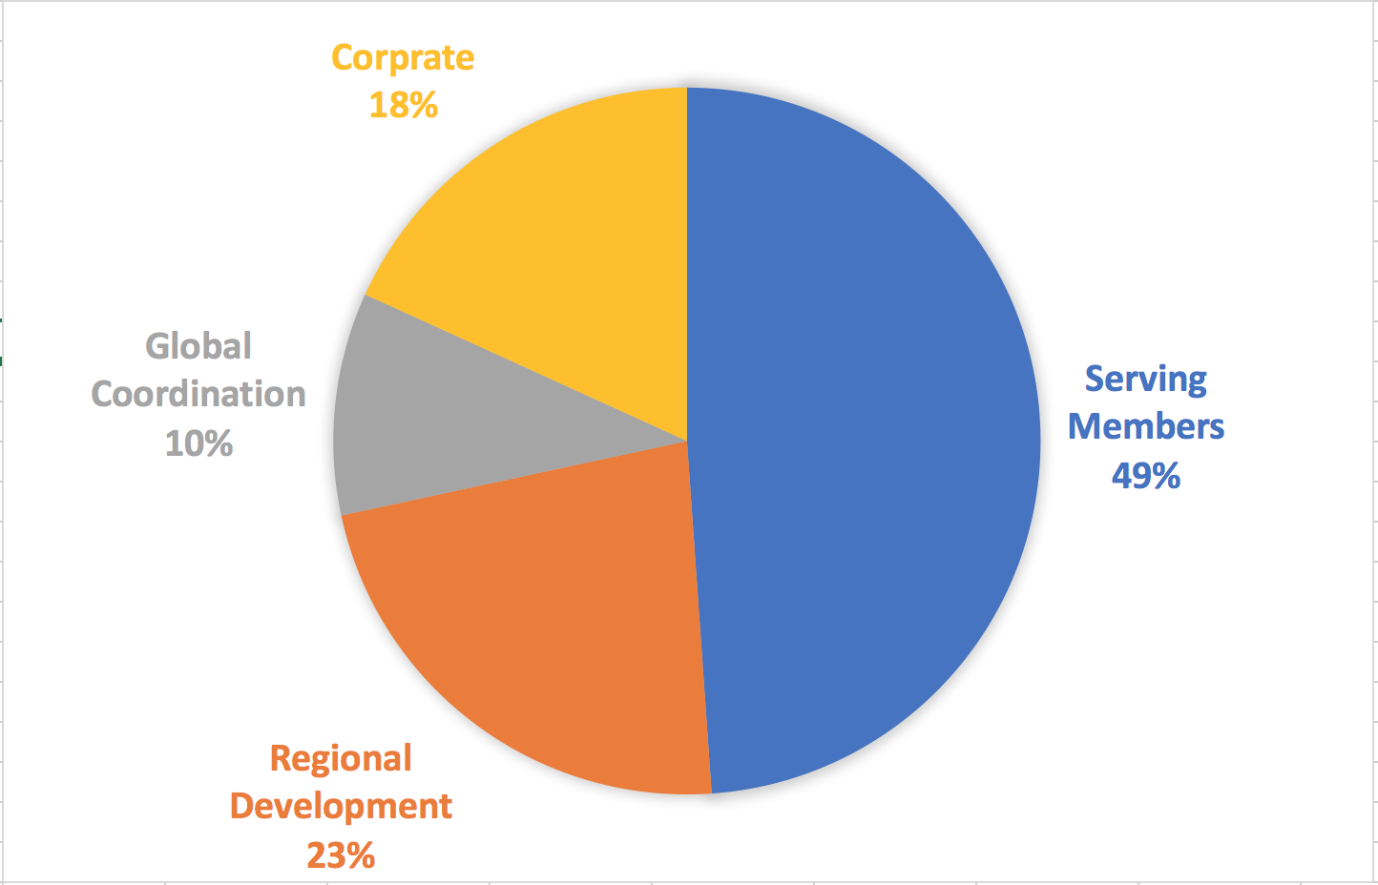
Expenses 2017
Notes:
In terms of our expenses, around 30% of them are dedicated on Regional Development and Global Coordination. What I call, taking care of the wider Ecosyste. This is how we see, how our member support us being seen, supportive of the Internet Ecosystem.

Slide 5
Membership
As at 31 Dec
Notes:
Total direct membership for 2016 was 5,994. At the end of 2017, membership stood at 6,557, or around 9% growth from 2016.
There are currently 7,579 NIR members, growth of 14% from 2016. Combined membership is 14,136.

Slide 6
IPv4…

Slide 7
IPv6…

Slide 8
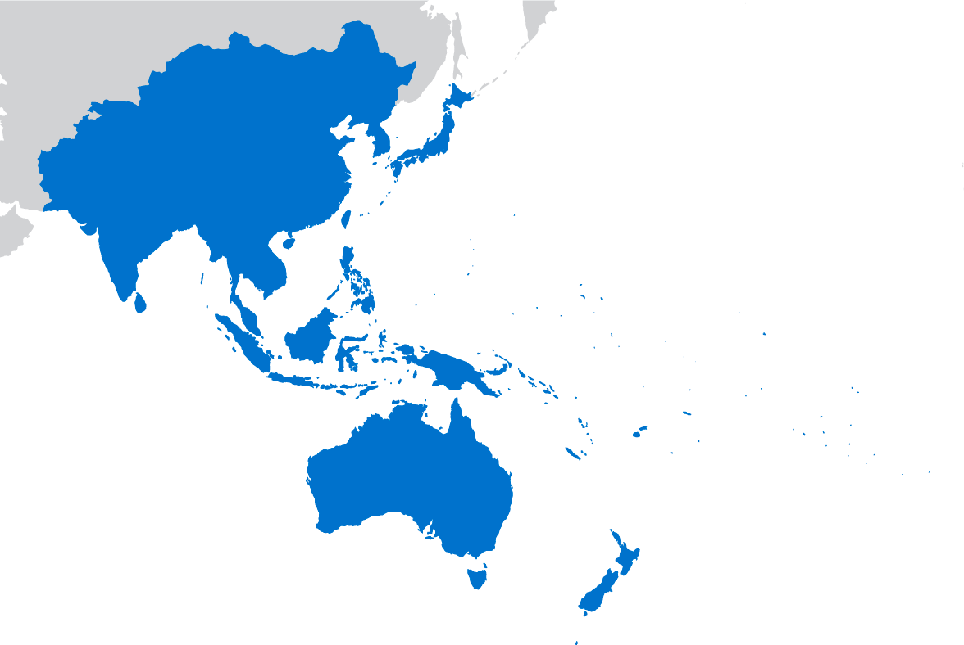
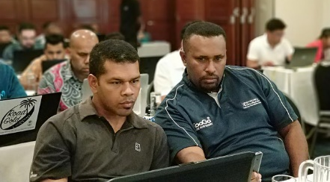
Community
NOGs: Participated in 24 NOGs
Root servers: J-root installed in NP; in progress at PG and FJ
MoUs: Sri Lanka CERT|CC, ISC, KISA, APIA, Netnod
IXP support: PG and FJ
Fellowships: 48 fellows at APNIC 44 (23 female), new Returning Fellows category
Sponsorship: 40 regional events (including 19 NOGs)
PacNOG 30, FJ

Slide 9
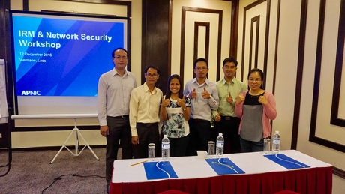
Training & TA
 | 2017
Face-to-face training Locations Trainees | 61 25 economies; 36 cities 1,988
Community Trainers Courses Economies | 11 21 8
eLearning sessions Trainees | 129 679
Training videos Views | 123 536,805
Technical Assistance (TA) | 17
Curriculum | New SDN course Network Security course fully updated
TA- Indonesia
Training, Lao PDR
training.apnic.net
Notes:
TA provided in Philippines, PNG, Fiji – ANY OTHERS

Slide 10
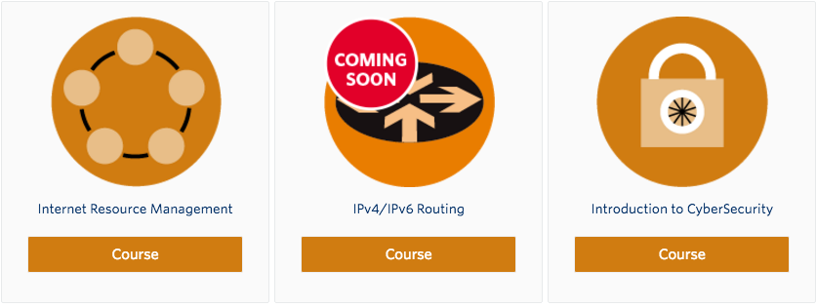
APNIC Academy
Launched April 2017
Free public access
‘Introduction to CyberSecurity’ and ‘IRM’
Enrolled: 1,852
Certified: 318
Coming soon:
IPv4/IPv6 Routing
Launched 2018
apnic.academy

Slide 11
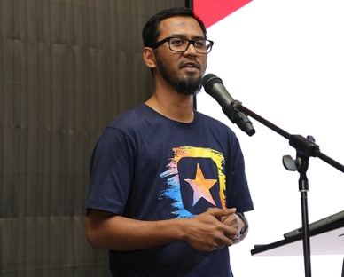
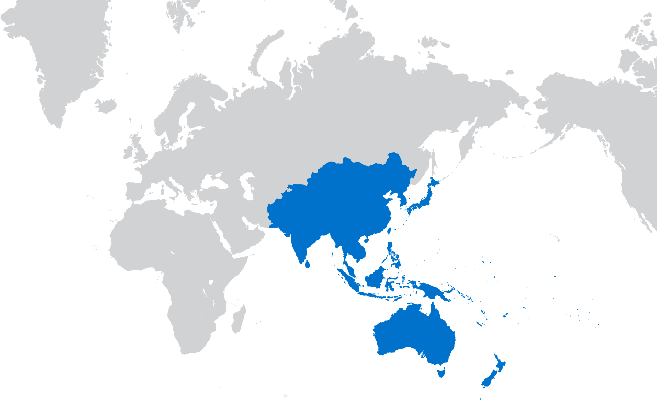
Security
30 security training courses
4 LEA training events: SG (2), FJ and KR
37 security engagements: APSIG 2017, APrIGF 2017, ASEAN, KISA APISC, CNCERT, INTERPOL SG, APCERT, RISE, ITU Cyberdrill
FIRST: MoU signed, FIRST events at APRICOT 2017 and APNIC 44
Adli Wahid re-elected to FIRST Board
Additional Internet Security Specialist
55 security blog posts
Adli Wahid
apnic.net/security

Slide 12
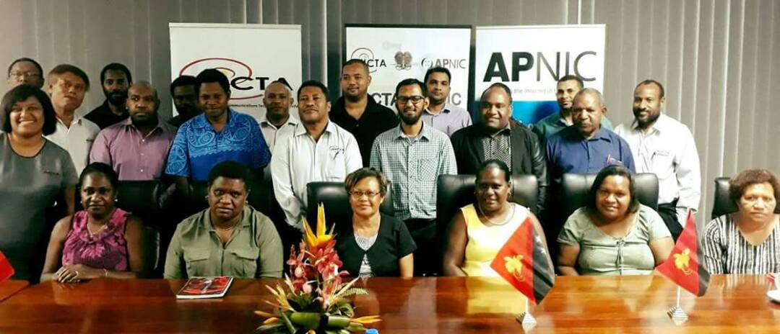
Pacific CERT Development
CERT.to established 2017
CERT-PNG launched 2018
More to come (FJ, VU, WS…)
Mentoring, training, and technical assistance provided
Additional funding via APNIC Foundation
Coordination with APCERT, CERT-Australia, Tonga CERT, ITU and others
CERT establishment workshop, PNG

Slide 13
Rootserver support
BIND 9.12 development
NSEC caching (RFC 8198) in DNS resolvers discard junk queries instead of sending them to the root
Reduces load on root servers – improves resilience, efficiency and scalability
Sponsored inclusion of functionality in ISC’s BIND 9.12 (open source)

Slide 14
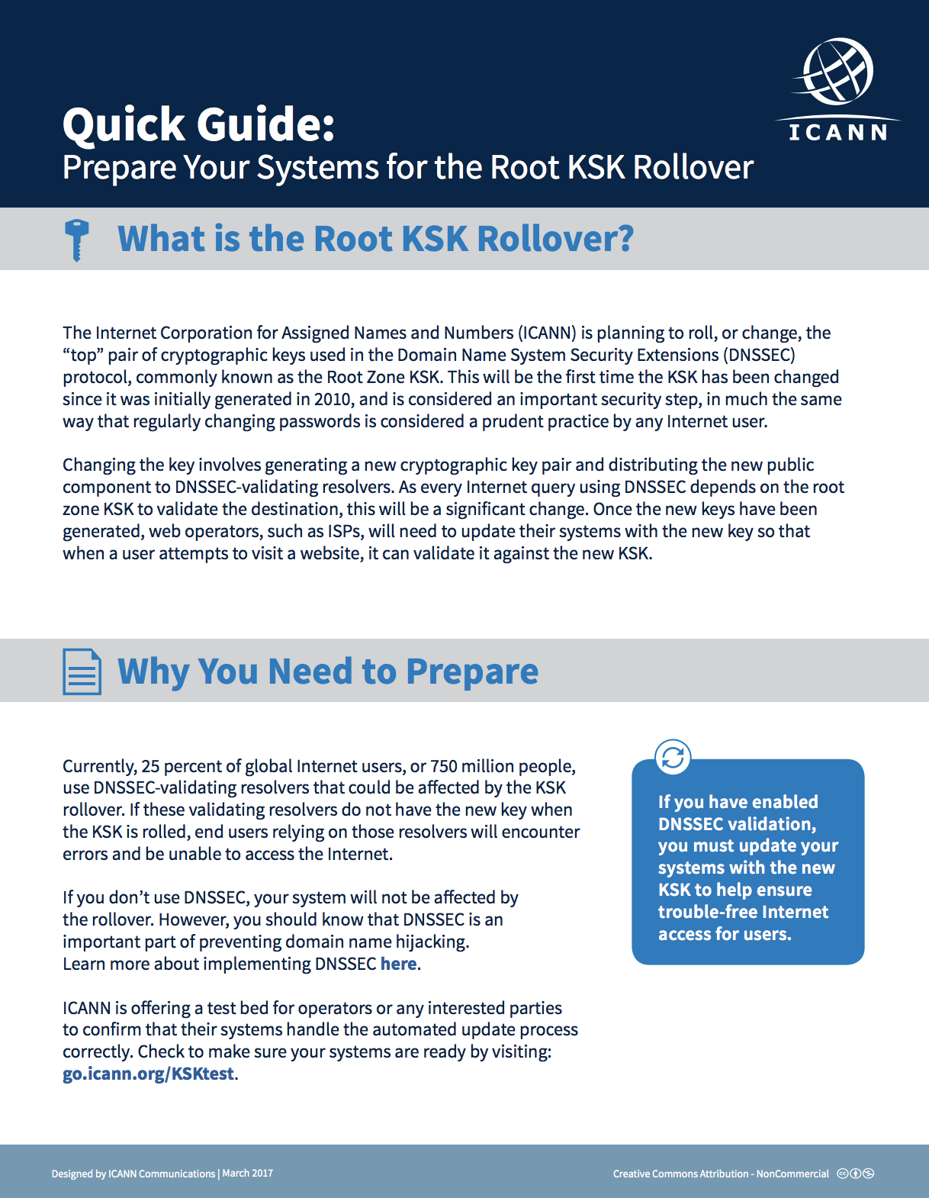
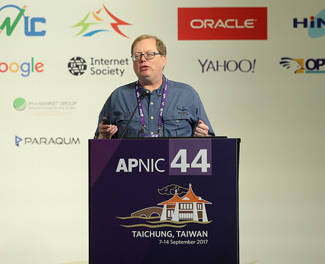
DNSSEC KSK Rollover
ICANN intends to rollover the DNSSEC Root Zone KSK (Key Signing Key)
APNIC supported ICANN by:
Identifying higher risk network operators performing DNSSEC validation
KSK rollover blogs, resources + translations
APNIC 44 information session
Communication activities to identified operators to facilitate smooth rollover
ICANN postponed keyroll to 2018
ICANN’s Ed Lewis @ APNIC 44
Ed Lewis, ICANN

Slide 15
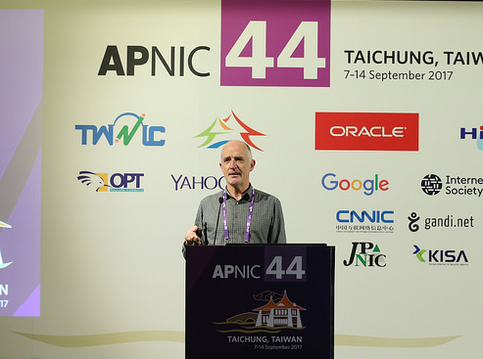
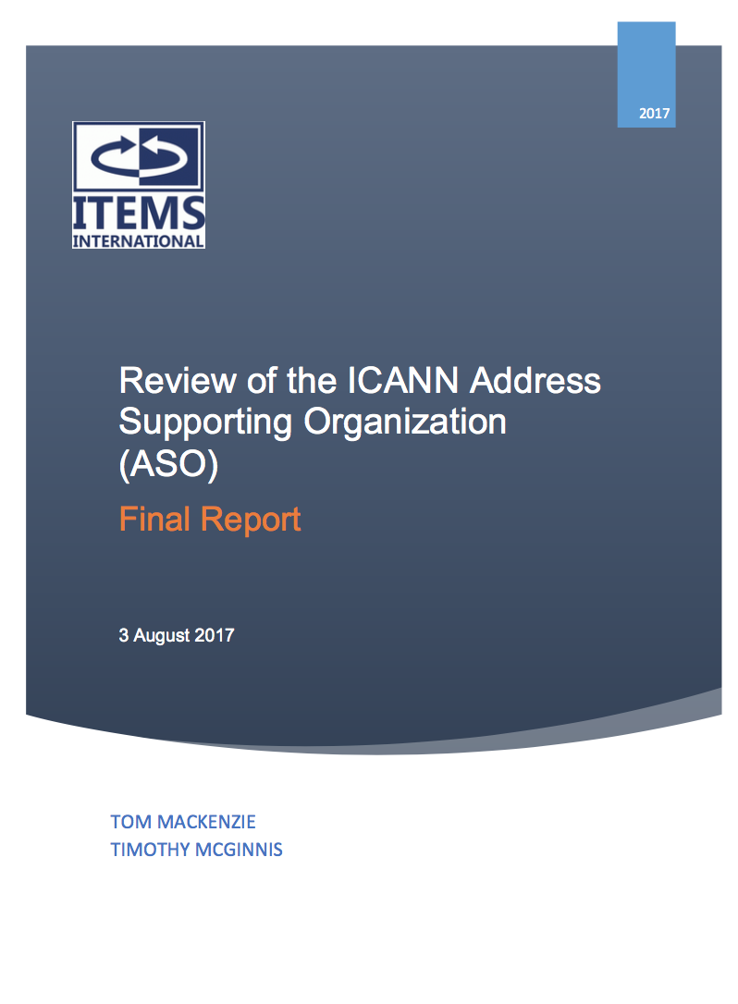
ASO Review
Independent ASO Review commissioned by NRO EC in 2017
Report published August 2017: concluded ASO has a continuing purpose in the ICANN structure + 18 recommendations for improvements
Community consultation held APNIC 44 to discuss findings
NRO launched global consultations in 2018 to discuss future structure of ASO
Consultation again at APNIC 45
ASO Review
@ APNIC 44

Slide 16
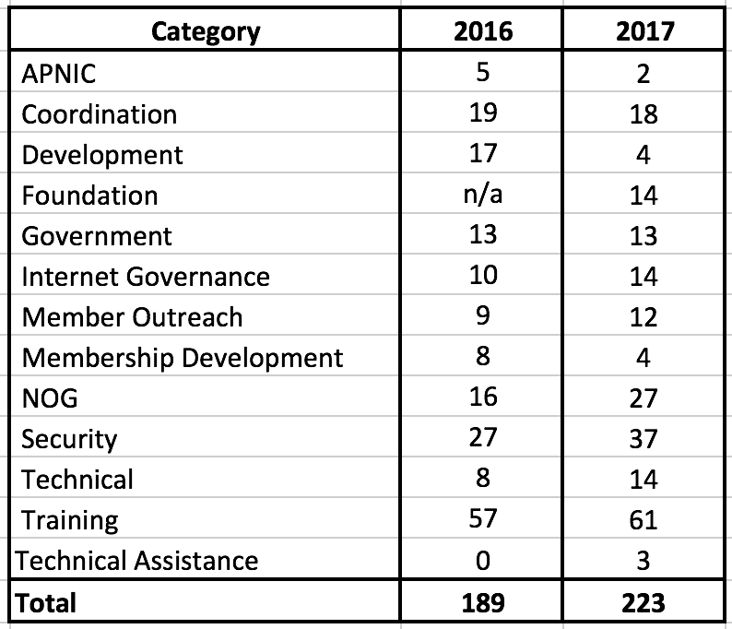
Development and Cooperation
15% growth!

Slide 17
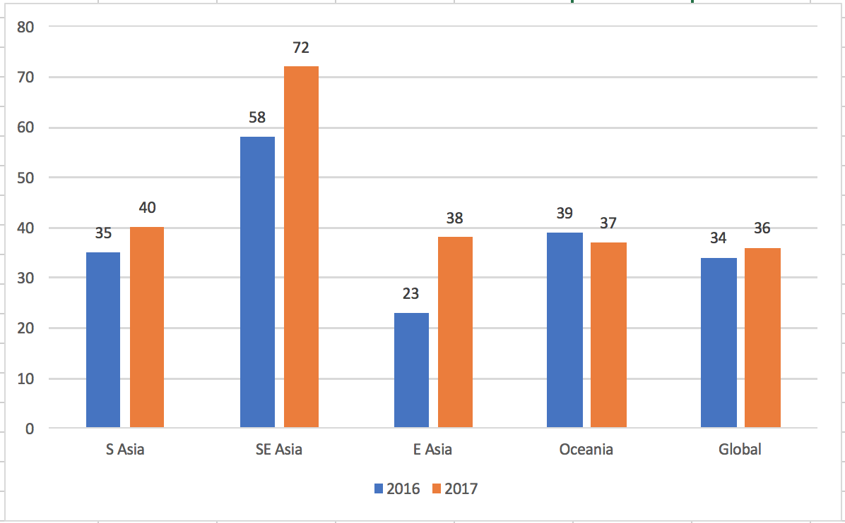
By subregion

Slide 18
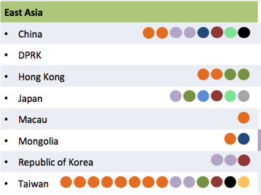
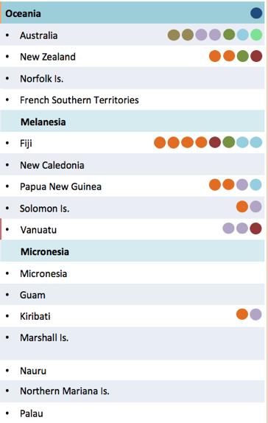
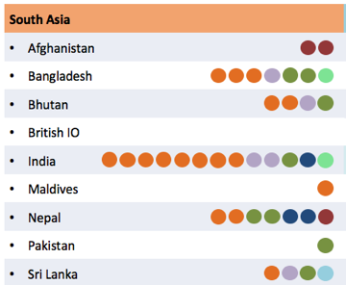
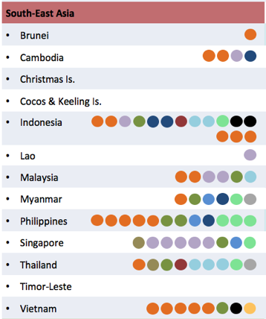
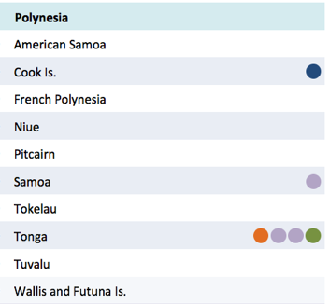
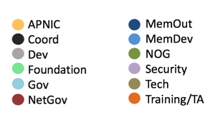
By subregion

Slide 19
APNIC Foundation
First year of operation: 2017
Mission: To build the APNIC Development Programme
Effectively, the “fund raising arm” of APNIC
Two staff seconded from APNIC: Duncan Macintosh, Sylvia Cadena
Three Board members appointed: Edward Tian (CN); Sharad Sanghi (IN); Sylvia Sumarlin (ID)
apnic.foundation

Slide 20
Next Conference
conference.apnic.net/46
Notes:
APNIC 46 will be held in Nouméa, NC.
Workshops: 6-10 September 2018
Conference: 11-13 September 2018
Registration will open soon.

Slide 21
Stay in Touch!
blog.apnic.net
apnic.net/social

Slide 22
Thanks!

