Slide 1
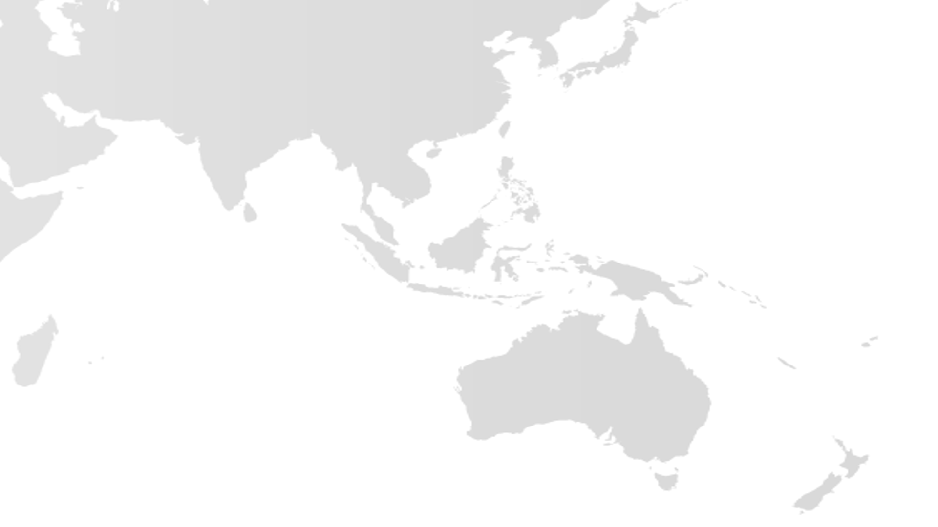
Asia, Australia and Pacific Islands Regional At-Large Organisation

Slide 2
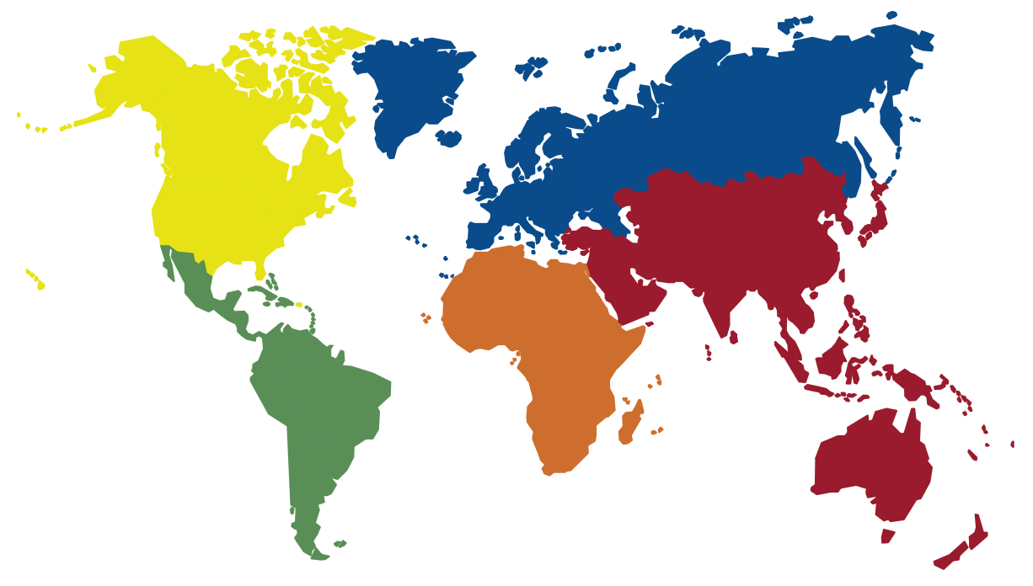
At-Large Community Organizational Structure
NARALO 23 ALSes in 3 out of 8 countries
EURALO – 37 ALSes in 17 out of 78 countries
The At-Large Community of ALSes and individual members are organized into five Regional At-Large Organisations (RALOs) based on their geographic regions
Plays an important role in the direction of ICANN, working to ensure that the expansion of the Internet serves the best interest of the Internet end user.
Advances policies and services that reduce confusion and abuse while enhancing security, accessibility and stable growth.
APRALO 53 ALSes in 29 out of 74 countries
LACRALO 54 ALSes in 21 out of 33 countries
AFRALO 50 ALSes in 30 out of 55 countries
At-Large Advisory Committee (ALAC) - 15 Members
10 selected by RALOs to serve on the ALAC (2 from each RALO)
Seat #15 on the ICANN Board is selected by the ALAC and the At-Large Community
5 selected by Nom Com to serve on the ALAC (1 from each region)

Slide 3
UPDATE
2018 ICANN meetings – Puerto Rico (March), Panama (June), Barcelona (Oct)
APRALO General Assembly – Abu Dhabi (Oct 2017)
nearly full representation of the 52 At-Large
Member organisations to discuss APRALO
Activities and goals
Key output APRALO Decade of Diversity eBook
At Large Structure Criteria Survey
Capacity among ALSes
Participation and Engagement
How do we get more members involved?
Outreach activities 2018
APRICOT Kathmandu
APrIGF Vanuatu (Aug)
Global IGF (TBC)
National ALS events

