Slide 1
APNIC Update
AP* Retreat
Ho Chi Minh City, Viet Nam

Slide 2
APNIC’s Vision
A global, open, stable and secure Internet that serves the entire Asia Pacific community

Slide 3
APNIC Activities
Serving APNIC Members
Supporting Regional Internet Development
Cooperating with the Global Internet Community
Notes:
This presentation is structured around APNIC’s three core areas of activity
In the top corner of each slide you see an icon to denote which area the activity falls under

Slide 4
APNIC Activities
Serving APNIC Members
Supporting Regional Internet Development
Cooperating with the Global Internet Community
Notes:
This presentation is structured around APNIC’s three core areas of activity
In the top corner of each slide you see an icon to denote which area the activity falls under

Slide 5
APNIC and NIR Membership
As at 31 December
Notes:
APNIC’s Membership continued to grow strongly in 2016 – up 14%
NIR sub account growth was even stronger – up 28%. The combined total at the end of 2016 was 12,624 Members
----
The total direct membership figure for 2015 was 5,268. Total direct membership for 2016 was 5,994, growth of 14%. Quarterly growth for 2016 was stable with around 250 new Members.
There were 6,630 NIR members at the end of 2016.

Slide 6
Annual IPv6 Delegations
As at 31 December
Notes:
The strong growth in membership translated through to continued growth in resource consumption – in fact, record levels of demand across IPv4, IPv6 and ASNs
IPv6 growth was certainly the most pleasing – 2016 saw a sharp increase in IPv6 delegations, more than doubling 2015
IPv6 adoption is now gaining strong momentum – notable deployments this year in our region included AIS Fibre in Thailand, FPT here in Viet Nam, Telstra Mobile in Australia, and Reliance Jio in India which is now the biggest IPv6 roll out in the Asia Pacific
-----
Total delegations in 2016 – 1,644
The majority of delegations have been a /32 (71%) which is the default allocation size for providers, followed by /48s which is the default assignment size for end-sites. Most came from normal allocations, instead of one-click.

Slide 7
Annual IPv4 Delegations
As at 31 December
Notes:
IPv4 too had a record year of delegations (mostly /22s as per the policy)
The demand for IPv4 hasn’t gone away, and based on current consumption trends I believe APNIC Labs has predicted the remaining IPv4 space will be depleted in around 3-4 years time
----
Total delegations: 3,401

Slide 8
Total IPv4 Addresses Transferred
As at 31 December
Notes:
This chart gives you another perspective on the transfers going on. While there may be fewer Inter-RIR transfers, they are much larger in size… and growing
Transfers can now take place between APNIC and both the ARIN and RIPE regions
Almost all the transfers between regions have the address space coming into the APNIC region rather than leaving it. 3.6 million addresses were transferred between APNIC and other regions – 96% of that was coming in.

Slide 9
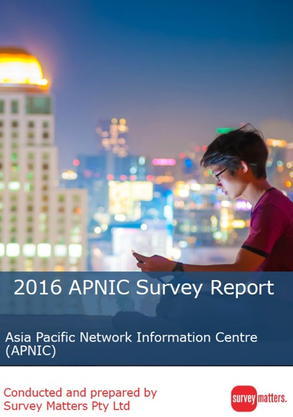
APNIC Survey 2016
Thank you for your participation!
Survey completed with 1,175 valid responses from 62 economies
Full report and EC response available for review: www.apnic.net/survey
Activity plan and survey response activity tracker live: www.apnic.net/survey-response-activity/
Notes:
2016 also marked two years since the last APNIC Survey. The 2016 Survey introduced some new processes to increase rigour, and the response from the community was excellent – almost 1,200 completed responses
The results were released during APNIC 42 in Colombo and if you haven’t yet had the opportunity to read the survey report, or the EC’s response to it, I encourage you to do so
It was pleasing to see a strong positive response to APNIC’s activities, and I’d like to thank you for that
The resulting feedback guided the EC and Secretariat in the development of the 2017 Activity Plan, which is available on the website as well as an updated survey response activity tracker so you can follow APNIC’s progress in delivering on thje things you asked for in the survey

Slide 10
Quality Management
Full ISO9001 recertification audit
Updated Quality System to AS/NZS ISO9001/2016
Includes knowledge management and risk management
Passed!
Notes:
Speaking of quality, in 2016 APNIC reached the three year milestone since first achieving ISO 9001 certification – this meant that we were due a full audit to maintain certification
The ISO 9001 standard had moved on in those three years, and now includes requirements around knowledge management and risk management
I’m pleased to say that APNIC passed the recertification with flying colours, and is now certified to the new standard: ISO 9001:2016

Slide 11
APNIC Activities
Serving APNIC Members
Supporting Regional Internet Development
Cooperating with the Global Internet Community
Notes:
Moving on to regional development now

Slide 12
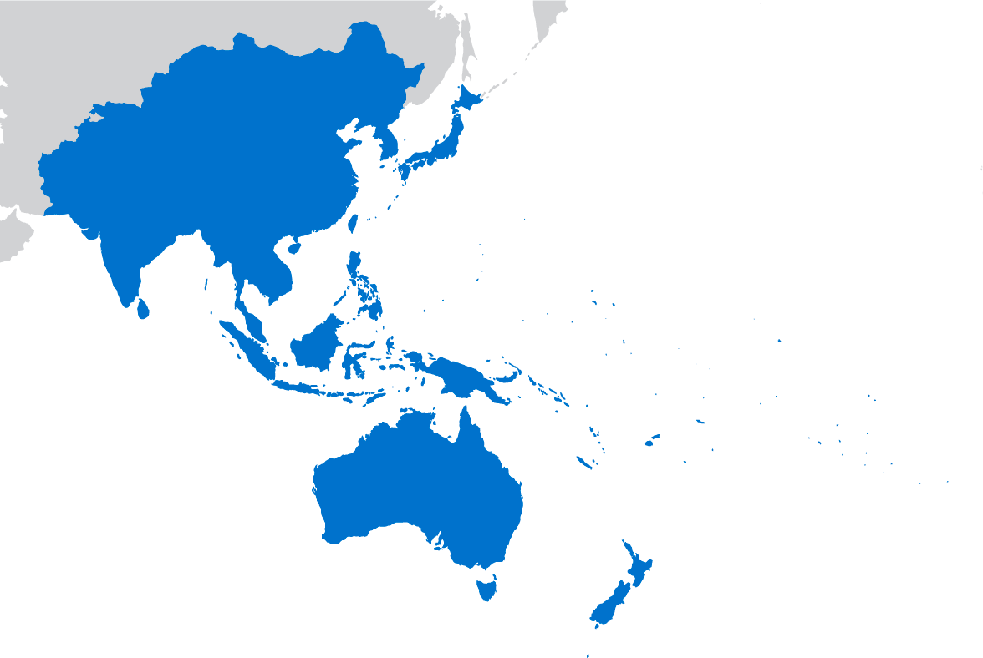
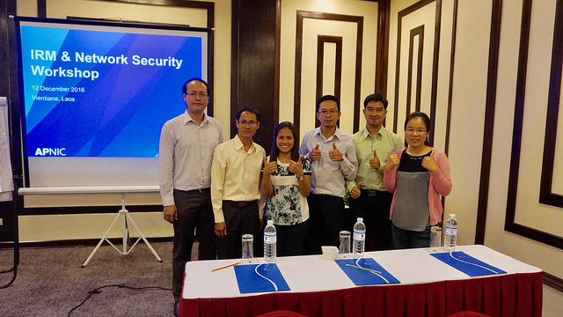
Training and Technical Assistance
62 face-to-face courses in 25 locations to 1,934 trainees
Nine community trainers delivered 12 face-to-face courses in six locations
883 trainees in 130 eLearning sessions
108 YouTube videos; 132,532 views
Updated IRM, IRR, Network Security, MPLS, SDN, NFV courses with new hands-on exercises
Technical Assistance provided to nine Members (ID, FJ, NC, BD, TL)
TA- Indonesia
Network Security workshop, Hong Kong
Training, Laos
Notes:
Training continues to be in high demand across the region
In 2016 we visited 25 locations to deliver 62 face to face courses
APNIC was helped in this endeavour by nine community trainers
If you’ve not heard of this initiative, it is something APNIC started last year, and nine recognised technical experts in the region volunteered to help support APNIC’s training by extending its reach
APNIC hopes to expand the number of community trainers in 2017, so if you’re interested in finding out more, get in touch with Nurul, APNIC’s training manager who can tell you more

Slide 13
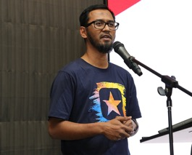
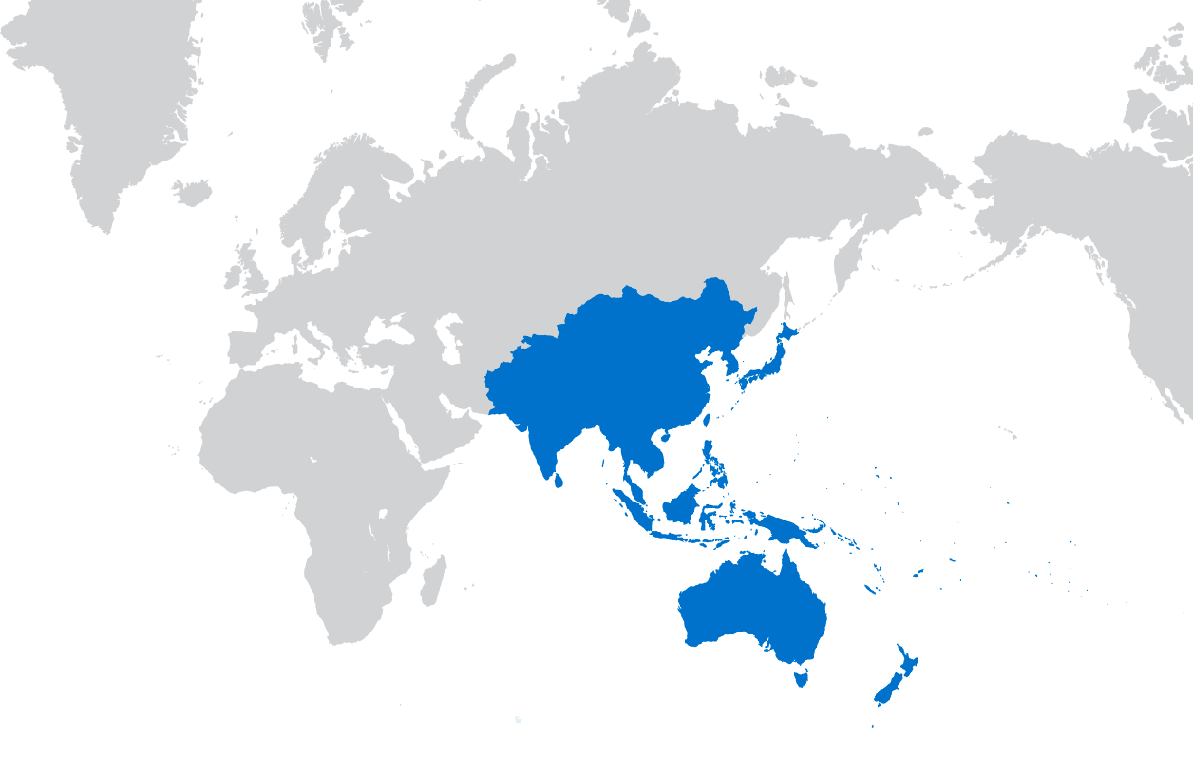
Security Outreach
Security training and participation at 27 NOG and CERT events
LEA conferences in Malaysia and Korea; continued engagement with Interpol
Training and support for creation of new Tonga CERT; exploring viability of CERT in Vanuatu
FIRST Tech Colloquia with APRICOT 2016, SANOG 28, APNIC 42
Paul Wilson joined GFCE Advisory Board
62 security-tagged blog posts published
Adli Wahid
Notes:
APNIC was extremely active in the security field in 2016. We know this is very important to Members, and that was confirmed in the APNIC Survey
The knowledge and contacts developed by APNIC’s participation in the security community were brought back to share within the APNIC community – a great example is the hosting of FIRST TC meetings at APNIC conferences but also SANOG and a FIRST-supported training session at PACNOG 19
APNIC is proud to have played a role in helping Tonga establish CERT.to, and this has sparked interest from other Pacific Island states on developing their own security response capabilities
To continue to boost APNIC’s security efforts, a second security specialist will be recruited this year

Slide 14
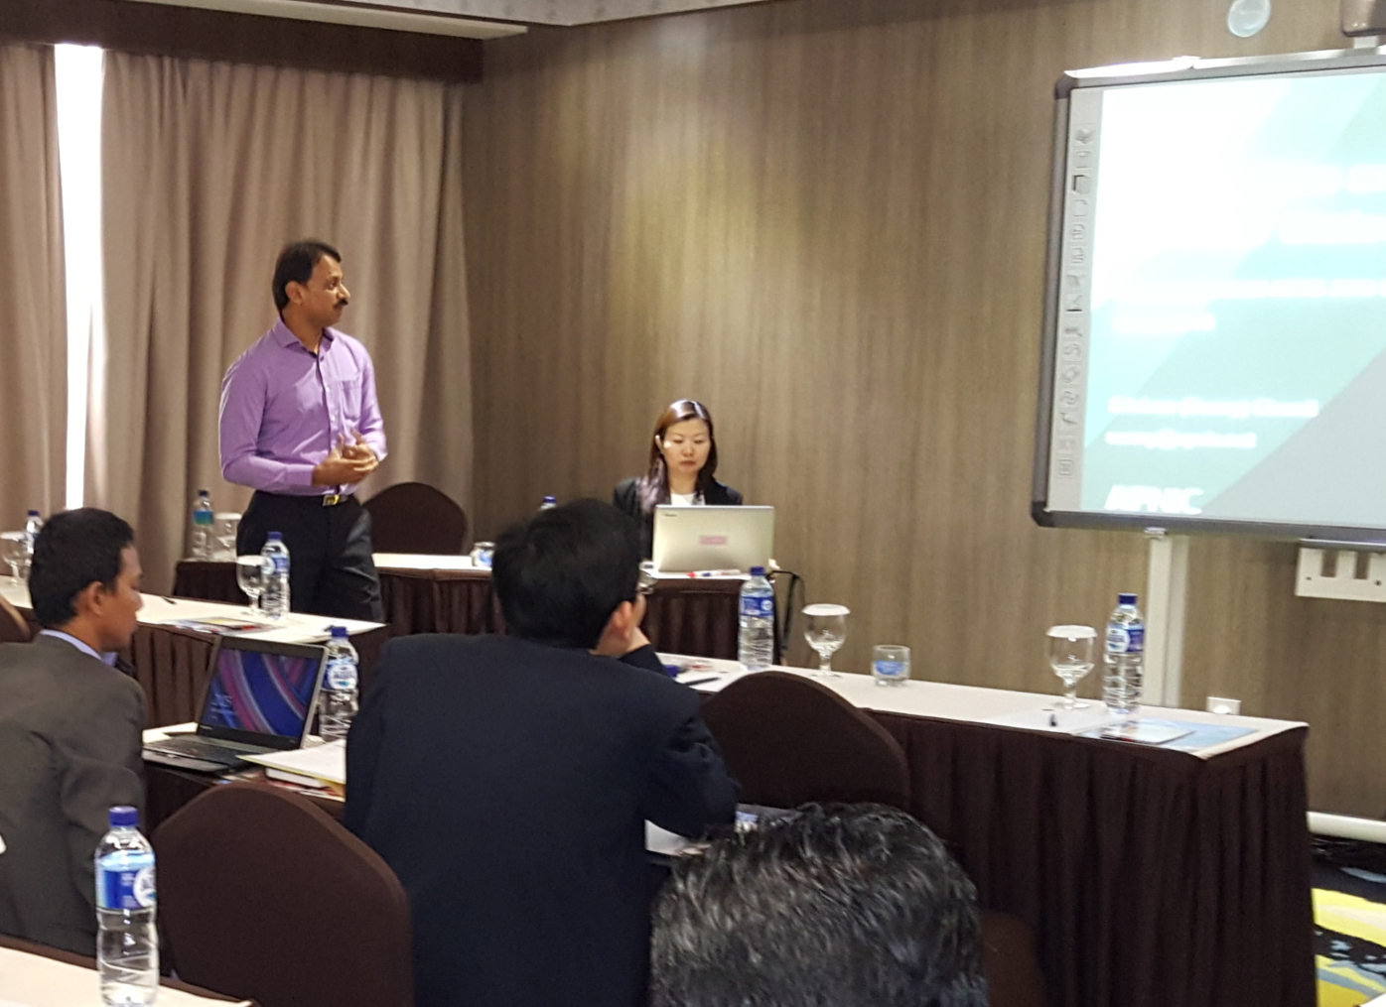
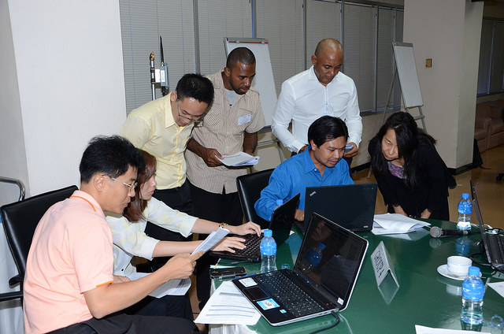
IPv6 Outreach
18 face-to-face training sessions, 501 trainees including IPv6 workshop with ITU in TH
36 elearning sessions reaching 245 trainees
Promoting IPv6 with presentations at 23 regional events
Input to policy makers to include IPv6 in UN ESCAP’s AP-IS plan
Assisted Singapore IDA’s IPv6 survey and ASEAN workshop
Supported IGF IPv6 Best Practices Forum
IDA IPv6 workshop
ITU/APNIC IPv6 workshop
APNIC/ITU IPv6 Workshop, Bangkok
Notes:
APNIC has actively promoted IPv6 / developed IPv6 capacity through training, technical presentations, and working with government policy makers
We remain committed to promoting IPv6 and helping increase its adoption – as I said earlier, there were some notable IPv6 deployments in the region this year, and APNIC was pleased to be able to help provide advice and testing assistance to at least one of those deployments in 2016
It’s not just reaching network operators – APNIC is also active in convincing government policy makers to include IPv6 among their priorities to help drive greater understanding and adoption

Slide 15
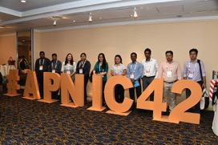
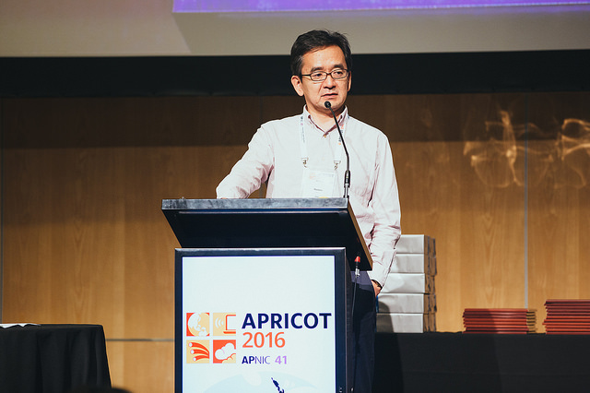
APNIC Conferences
 | APRICOT 2016 | APNIC 42
Delegates | 531 | 332
Economies represented | 53 | 39
APNIC Members represented | 125 | 133
AGM delegates | 237 | 287
Remote sessions viewed | 1,238 | 1,545
Fellows Women Youth | 22 6 | 52 20 14
APNIC 42
APNIC 42
APRICOT 2016
APRICOT 2016
Notes:
The conferences seem to keep on growing in attendees and participation, and I hope you have all found this week to be a productive one
Both APRICOT 2016 and APNIC 42 were great events, and thanks again goes to both our Sri Lankan and Bangladeshi hosts for their support of APNIC 42 in Colombo following the late relocation of the conference.

Slide 16
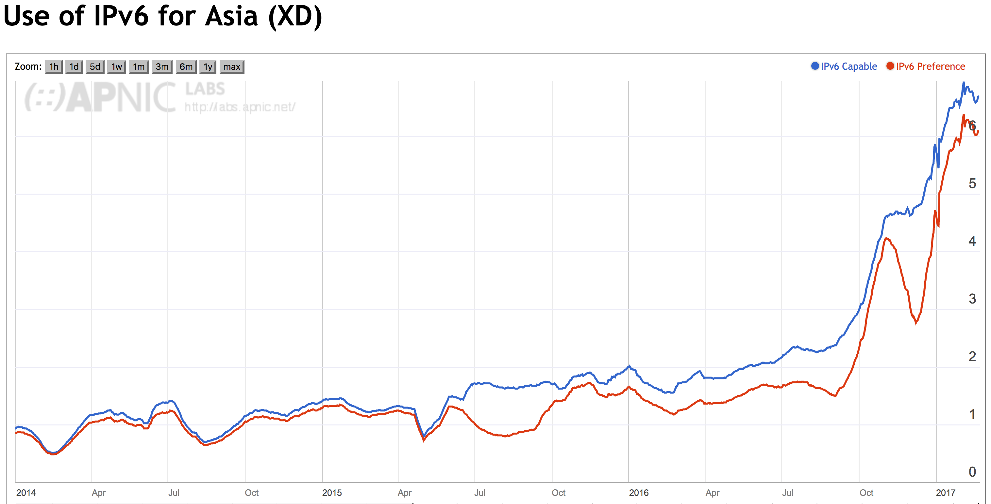
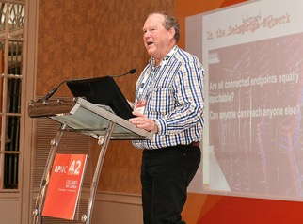
APNIC Labs
Over 7 million measurements per day, measuring IPv6, DNSSEC, DNS
Data for DNS Root Zone key roll and ICANN’s Universal Acceptance (IDN) program
Measurement and testing support to operators planning IPv6 deployment
Presentations at 18 forums including IETF, RIRs, ICANN, DNS OARC, NOGs, OECD
Geoff Huston continues on ICANN SSAC, and contributing to ICANN GAC Public Safety Working Group
Research to help the APNIC community make informed technical decisions
Notes:
APNIC Labs continues to deliver industry-leading research to help the APNIC community make informed technical decisions
Hopefully most of you got along to at least one of Geoff Huston’s sessions here at APRICOT to hear about the resulrts of some of this research
The upcoming DNS root zone KSK rollover continues to be an area where APNIC provides research data to assist ICANN and the community, and we’re pleased to be able to play our part in helping the community prepare for technical challenges like this

Slide 17
APNIC Foundation
Officially incorporated in Hong Kong in September 2016
First year of operation to begin in 2017
Partner & Project | Amount
IDRC for Seed Alliance | 500,000 CAD
JICA for APNIC Academy | 20,000 USD
ITU for IPv6 Training | 9,500 USD
ITU for IXP Training | 4,300 USD
https://apnic.foundation
Notes:
The APNIC Foundation was officially incorporated in 2016 and is now up and running
The aim of the Foundation is to secure alternative sources of funding to help support APNIC’s development activities such as training, technical assistance, fellowships, ISIF grants and more
While the Foundation was being created last year, project funding was secured from several partners to help support development activities. It is expected the Foundation will help attract more of this type of funding in 2017 and beyond

Slide 18
APNIC Activities
Serving APNIC Members
Supporting Regional Internet Development
Cooperating with the Global Internet Community
Notes:
Finally let’s look at global cooperation activities

Slide 19
IANA Stewardship Transition
Plan approved by USG and stewardship of functions transferred to global community on 30 September 2016
SLA for IANA Numbering Services signed at ICANN 56 by RIRs and ICANN
APNIC EC passed a resolution at APNIC 42 thanking the APNIC community for their support of the process
“This is a celebration of the process as much as it is of the results. This process has – once again – demonstrated that the multistakeholder model works, and is the best governance model to maintain a growing, stable and open Internet.
No single person, company, organization, or government runs the Internet; it belongs to everyone.”
Excerpt from Colombo Statement
Notes:
This was a huge achievement – and one which we promised to stop talking about at APNIC 42 in Colombo!
But if you’ll indulge me for one last time, again I’d like to thank everyone in the APNIC community who contributed to this historic milestone in 2016. Well done!

Slide 20
Engagement Summary
Notes:
These two pie charts provide an overview of APNIC’s face-to-face engagement activity around the region and the world
The majority of APNIC’s work is in the region – 82% - with the majority of face-to-face activity being training related, followed by security engagements

Slide 21
Next APNIC Conference
Website and Registration available soon
Notes:
APNIC 44 in Taiwan is coming later this year – the website and registration will both be online shortly so stay tuned for more news. We’d love to see you all there

Slide 22
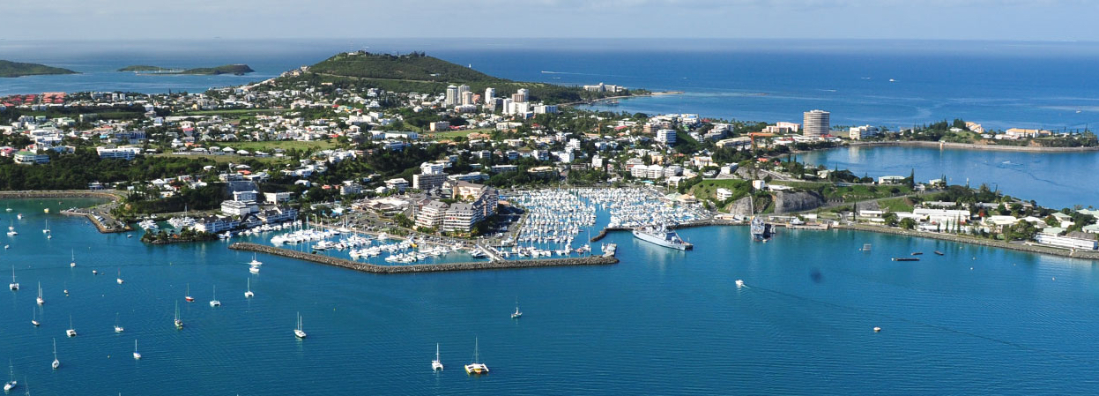
Coming later…
APRICOT 2018, Kathmandu, Nepal
19 February to 1 March 2018
APNIC 46, Noumea, New Caledonia
6 to 13 September 2018
Notes:
Following APNIC 44, the next two conferences will be in Kathmandu, Nepal, and sunny Noumea, New Caledonia in 2018

Slide 23
Stay in Touch!
blog.apnic.net
apnic.net/social
Notes:
Hopefully this report has given you a good snapshot of the year that was, but to stay in touch with what’s happening at APNIC and within the community, visit the blog or any one of APNIC’s social media accounts to learn more

Slide 24
Thank you
Notes:
Thanks very much for your time and attention!

