Slide 1
AN APTLD UPDATE
A presentation for
the AP* Retreat
Taichung, Taiwan
10 September 2017
By Hiro Hotta, JRPS
on behalf of APTLD

Slide 2
APTLD in 2017
56 members (43 ordinary and 13 associate)
No new members joined
Some members undergo fairly challenging transformational processes, which may be :
- Executive management change;
- Organizational structure and operations change;
Policies change
A number of prospective members undergoing redelegation (no chance to engage with them until it is over)
F

Slide 3
Challenges
Rapidly changing industry landscape and competition on the part of new GTLDs;
The continuing gap between members in terms of institutional, technical and administrative maturity;
Some members continue staying incommunicado (Oceania & Middle East)
Quite a number of members have remained vulnerable to external shocks, and their advancement stalled
F

Slide 4
Major Activities to Date to Address Challenges
Proactive communication and outreach efforts
Building a new corporate website poised to become a pivot of the communication and outreach efforts
Forming alliances with I* orgs and other organizations to address some members’ challenges in a more holistic way
A peer technical assistance project for .TL by auDA ( with APTLD’s consulting, facilitation and co-sponsorship); more under development
Reaching out to prospective members in EMEA (Azerbaijan, Uzbekistan, Bahrain, Kuwait); Asia (Laos, Myanmar, Brunei), Oceania (Kiribati, the Marshall Islands)
Procurement of Adobe Connect Platform and Webinars for Members (2 to the date)

Slide 5
Cementing Cooperation with I*orgs
Joint initiatives with APNIC (e.g. at APTLD71; a marketing session at APTLD73 (in the making); and a great webinar on DNSSEC for Afghanistan)
Outreach activities with ISOC AP: thanks to a target grant from ISOC AP Bureau, a more intense in-person engagement with Laos and Myanmar; ISOC’s leadership presented at APTLD71
Extensive collaboration with the APAC Hub (teamed up for APIGA, APrIGF)
Cross-pollination initiatives with the peer ROs (e.g. an APTLD Board members presented at the AFTLD Meeting; APTLD co-sponsoring AFTLD’s participation in APTLD72; a record number of CENTR members to join APTLD72)
APTLD-sponsored Fellow selected by ISOC for IETF100
Joint APTLD/ISOC Fellowships to APTLD Meetings
MoU with RIPE NCC to be signed at APTLD72 (with RIPE team to contribute 2nd time in a row)

Slide 6
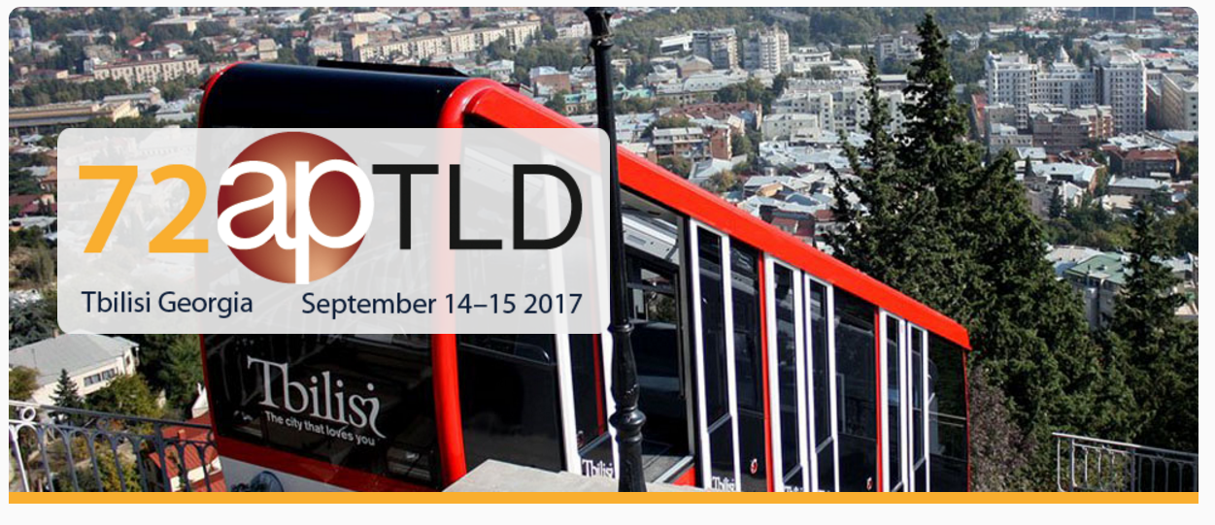
September 14-15 2017
Courtyard Tbilisi, Georgia
Hosted by

Slide 7
Where On Earth Is Georgia?

