Slide 1
APStar Secretariat
Sweet Mae Monteclaro intERLab, AIT APStar Retreat Meeting, New Delhi 26 February 2012

Slide 2
Secretariat Funding
APIA Annual Funding since 2006
Annual funding: USD 5,000
Support for the Secretariat operations
Thanks to APIA and its Board members

Slide 3
Meeting Chairs
Toru Takahashi
Kilnam Chon
Atsushi ENDO
Shigeki Goto
Hiro Hotta
Izumi AIZU
Jun Murai
Paul Wilson
Kenny Huang
Abisak Chulya
Vincent W.S. Chen
Suguru Yamaguchi
Kanchana Kanchanasut
Zita Wenzel
Xing Li
Ching Chiao
Bayani Benjamin R. Lara
Don Hollander
Sir Jae Chul
Tommy Matsumoto
Sylvia Sumarlin
Jian Zhang
Nii Quaynor

Slide 4
Meeting Venues
2010 Kuala Lumpur, Malaysia (February)
Gold Coast, Queensland (August)
2011 Hong Kong (February)
Busan, South Korea (September)
2012 New Delhi, India (February)

Slide 5
Meeting Attendance
Average of 20-25 members attending
each meeting
Last meeting attendees:
Kuala Lumpur, 2010 – 22
Gold Coast, 2010 – 14
Hong Kong, 2011 – 43
Busan, 2011 - 16

Slide 6
APStar Website
apstar.org
Events from all AP organizations are encouraged for updates.
Contact: sec@apstar.org
We encourage all member organizations to help update the contents of the website.

Slide 7
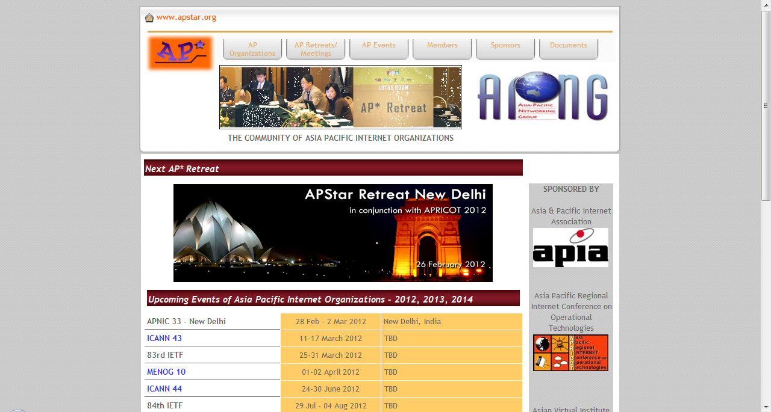

Slide 8
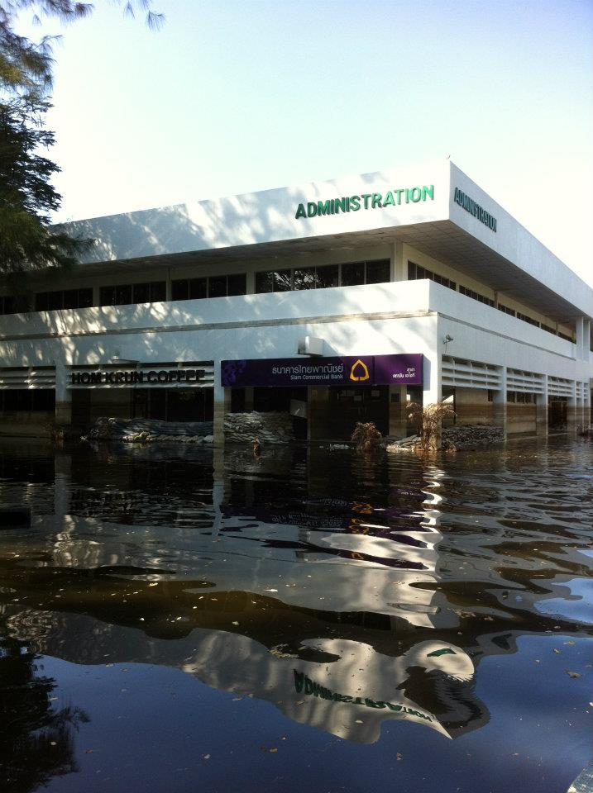
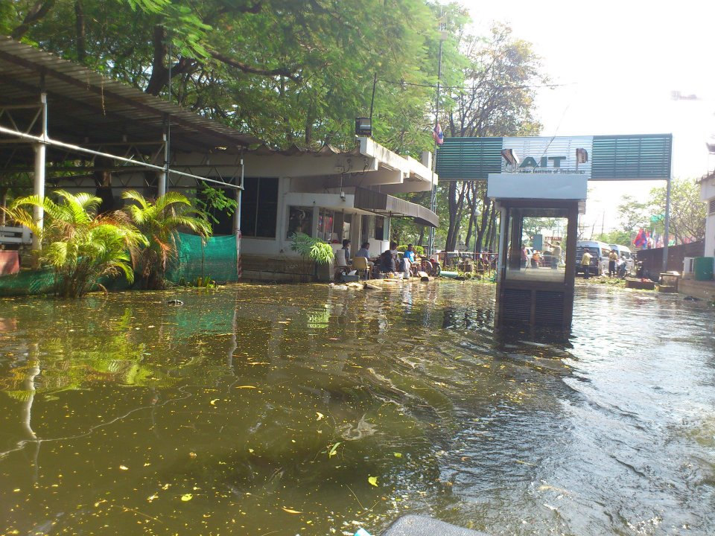

Slide 9
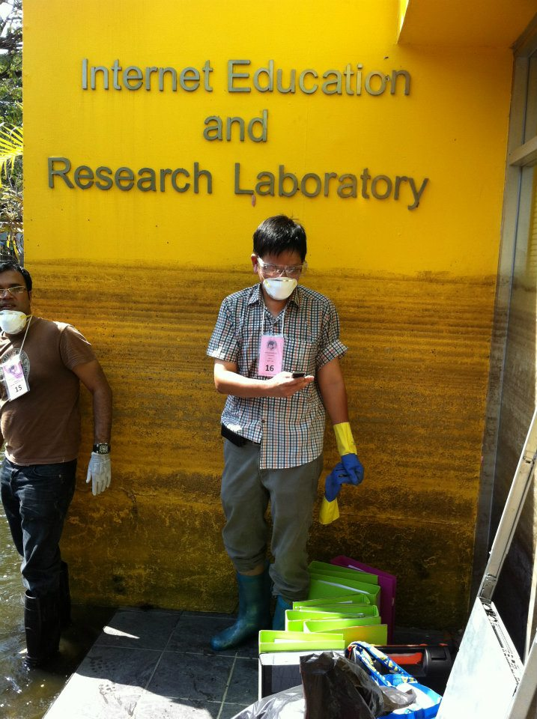

Slide 10
APStar Retreat Delhi Meeting
Chairs:
Ching Chiao, DotAsia
Host: APRICOT 2012
Local Organizers: ISPAI, NIXI
Dr. Govind, CEO of NIXI
APIA and APIA Board members for the continuous support

Slide 11
APStar Future Directions
Existing Status: Coordinator
2011 Busan Meeting
APStar to reduce the meeting frequency to once a year?
Suggestion to have APStar Newsletter (Quarterly)

Slide 12
AOB and Future Meeting
Colombo, Sri Lanka
34 APAN Meeting (25-29 August 2012)
Phnom Penh, Cambodia
APNIC 34 (27-31 August 2012)
Singapore
APRICOT 2013 (19 February – 1 March 2013)

Slide 13
AOB and Future Meeting
sec@apstar.org
www.apstar.org
Sweet Mae Monteclaro
Internet Education and Research Laboratory
Asian Institute of Technology, Thailand

