Slide 1
AusNOG
Presentation for the AAF/AP* Meeting at Apricot/APAN 2011

Slide 2
Agenda
Mailing List
Conference
Web Site

Slide 3
Mailing List
ausnog@ausnog.net
Open access list
Subscription details at
http://lists.ausnog.net/mailman/listinfo/ausnog
Has a “long” charter, see web site
http://www.ausnog.net
Reactively moderated
Currently over 1100 subscribers

Slide 4
Conference
Held Annually
In Sydney during September
This year conflicts with SANOG ☹
Organised by AusNOG Pty Ltd
An Event Management company is contracted for event planning & logistics
Note only one of the directors lives in Sydney

Slide 5
AusNOG Pty Ltd
An Australian “Pty Ltd” company
Allowed it to be created quickly for AusNOG-01
Could be transformed into a non profit
Needed a company so we could get a bank account, make commitments, pay bills, organise speakers & sponsorship, etc.
Has a cash float of approximately $22,000
Needed to pay early deposits before any registrations

Slide 6
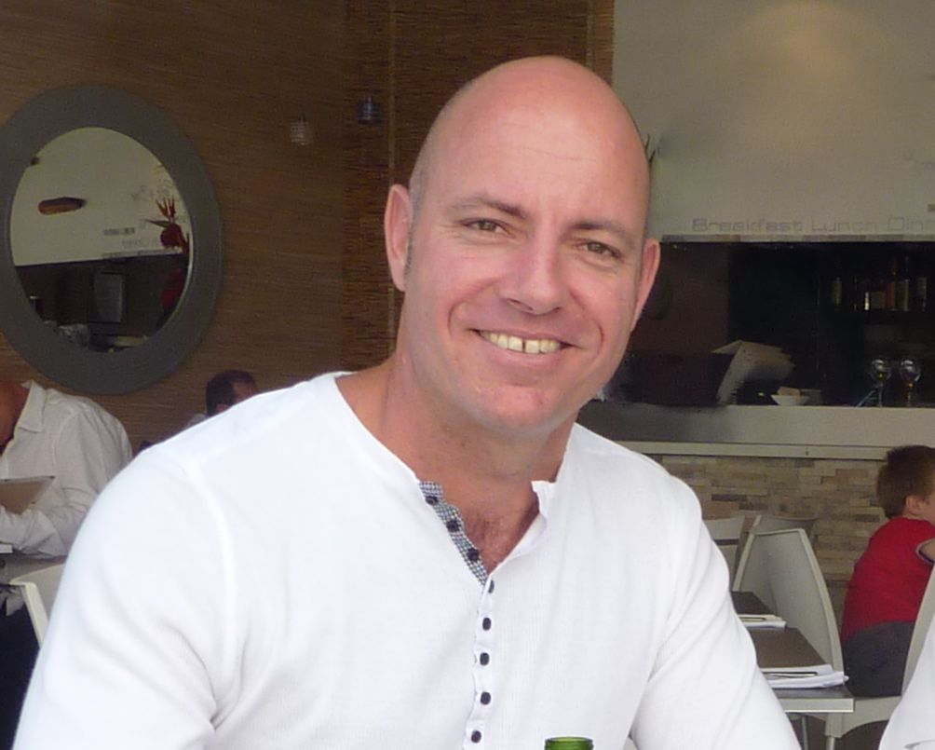
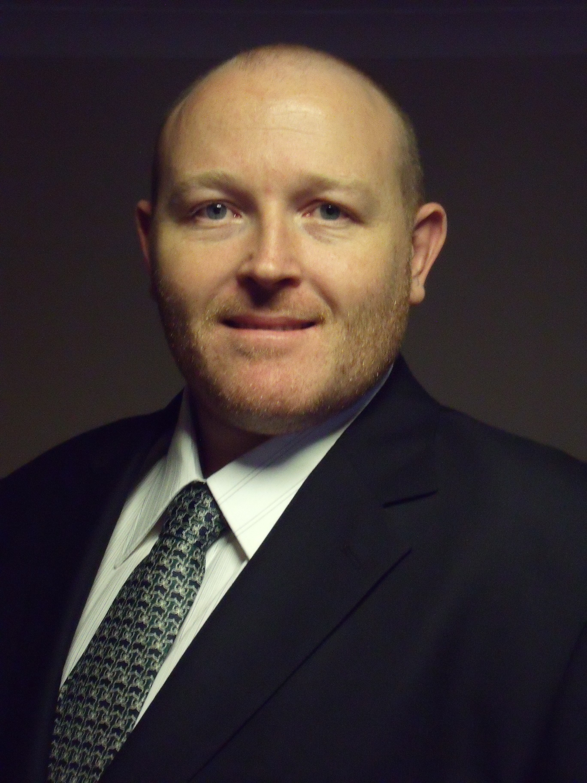
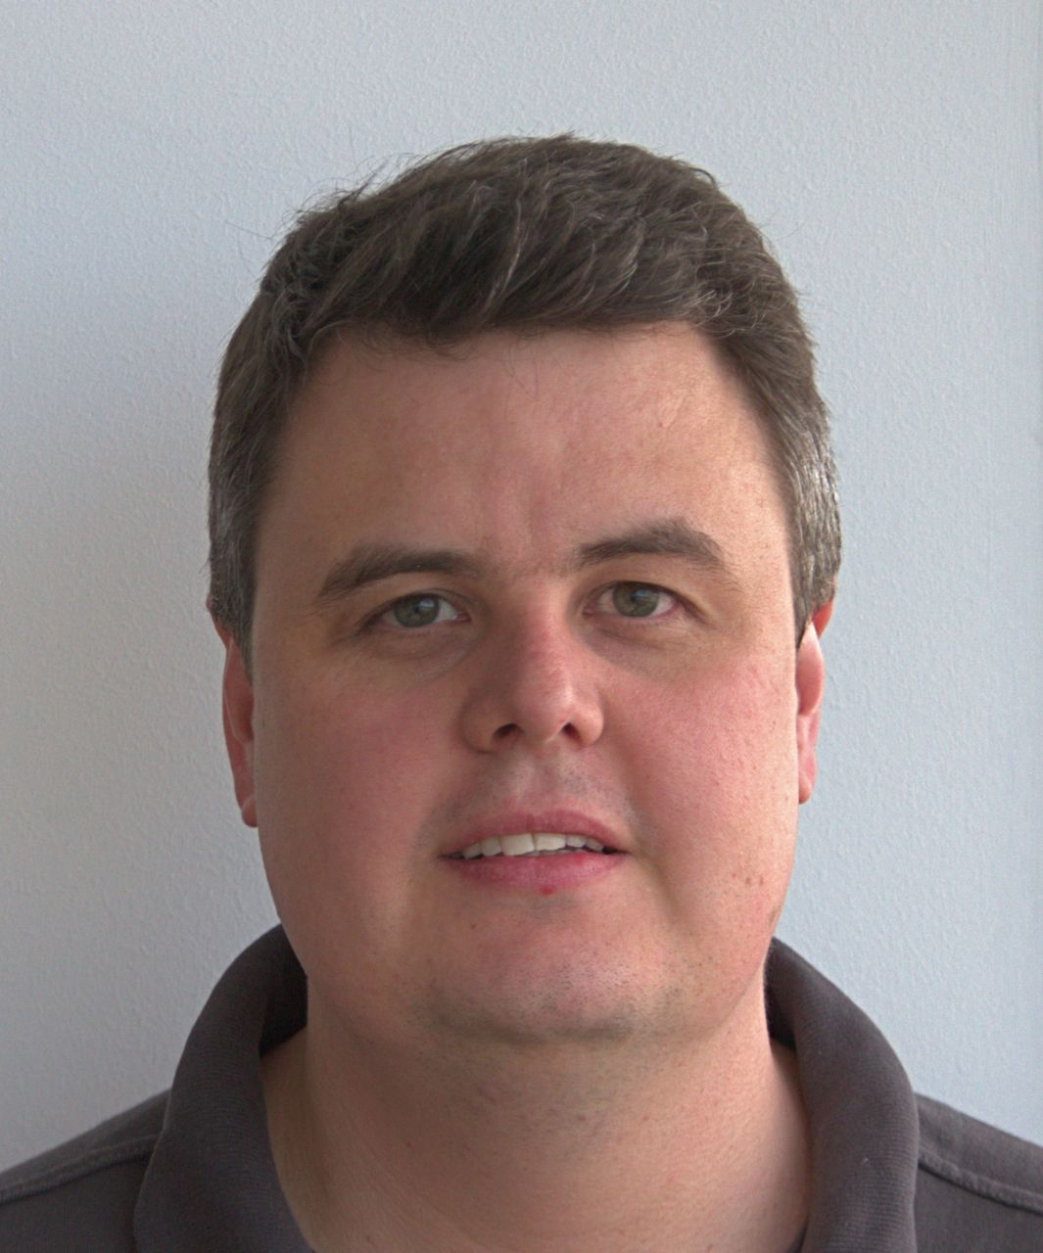
Board of Directors
David Hughes
Terry Manderson
Matthew Moyle-Croft
Mark Prior
James Spenceley

Slide 7
Conference Logistics
Full programme over two days
Watch for Call for Papers!
Mix of domestic and international speakers
Aim to create a mixed programme of topics to provide something for everyone
Small collection of loyal sponsors
Kept sponsor base small and reward loyalty
Resulted in a waiting list!
Hotel as a venue
Close to capacity, sold out last year
Includes lunches and dinner

Slide 8
A look under the hood
Conference costs between $100k and $150k to run
Target size of 180 to 200 attendees
Capacity of hotel ballroom in classroom style
Use second ballroom for lunches & foyer for sponsor stands
Aim to cover 50% of costs via sponsorship
Target ticket price < $500

Slide 9
AusNOG-05
15 & 16 September 2011
Four Seasons Hotel, Sydney
Further announcements on AusNOG mailing list

Slide 10
Web Site
http://www.ausnog.net
AusNOG Charter
Holds archive of conference papers
Pointers to mailing list & archives

Slide 11
Thanks
Feel free to hassle MMC or me if you want further info
Consider submitting a paper!

