Slide 1
APNIC Update
Paul Wilson

Slide 2
APNIC news

Slide 3
Resource Certification
Digital certificates verifying resource holdings
For security, routing, authorisation
As per RFC
MyAPNIC certificate services
Generation and management of certificates for all members and all resources
In production from this week
Other services under development
Provision of “hosted” service by EOY

Slide 4
APNIC fees - USD exchange rate
AUD $1.27 *
Youch!
* Official AUD-USD exchange rate forecast for 2007, on which APNIC”s budget was based.

Slide 5
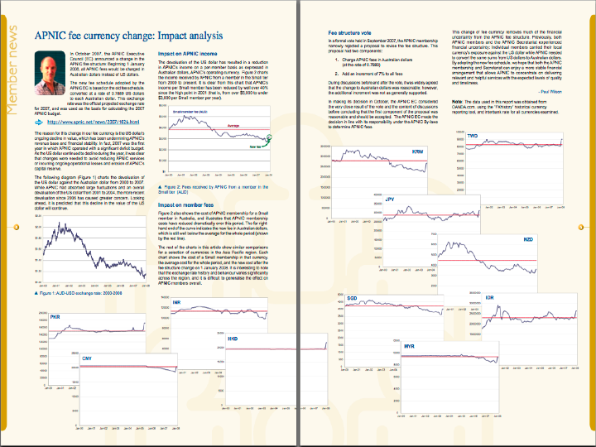
http://www.apnic.net/apster
http://www.apnic.net/apster

Slide 6
APNIC Survey 2009
Members and Stakeholder survey
Bi-annual input to APNIC planning
Independent – Dr John Earls, KPMG
Anonymous response guaranteed
IP addressing survey
IPv4 consumption and contingencies
IPv6 transition planning
Schedule
Preparations begin this week
Survey release early December
Report for APNIC 27, Manila, 2009

Slide 7
ISIF
Information Society Innovation Fund
Competitive grants programme for innovation Internet technologies and applications
Successor to PAN R&D Grants Programme
IDRC, APNIC, ISOC and Dot Asia
APNIC funded to provide secretariat and administrative support
http://www.isif.asia

Slide 8
IP address status – IPv4 and IPv6

Slide 9
IPv6 status
Transition is slow
Lack of user demand
Lack of ISP deployment
Slow vendor/software implementation
Why?
Transition cost is significant
No immediate or short-term ROI
Business case is non-existent
ISPs could deploy but choose not to

Slide 10
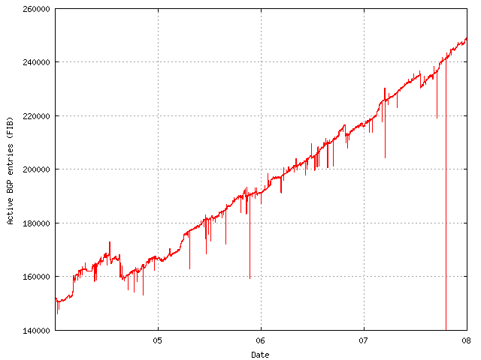
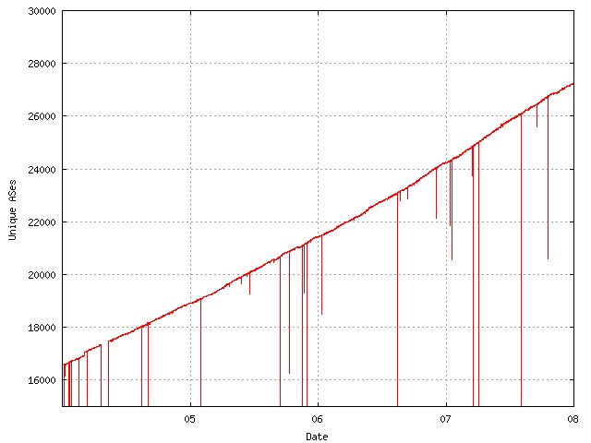
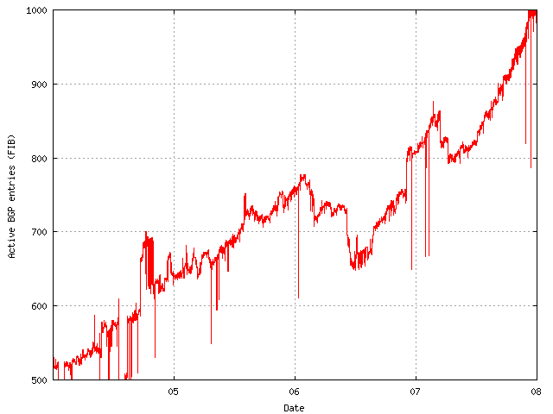
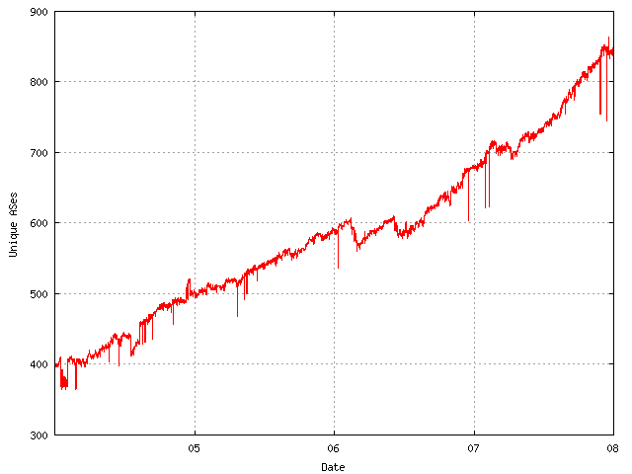
IPv6 status
250,000
27,000
67%
60%
IPv4
IPv4
ASN
1,000
850
100%
110%
IPv6
IPv6
ASN

Slide 11
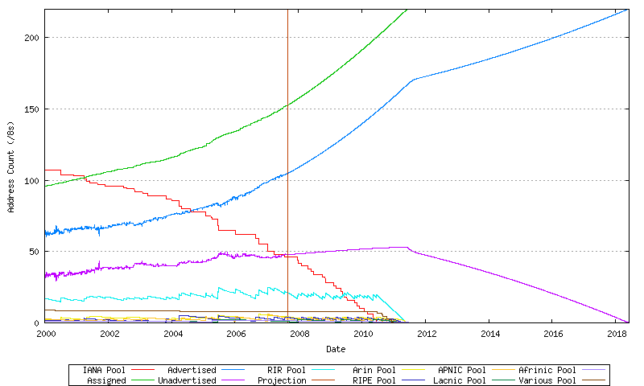
IPv4 status – Consumption
RIR allocations
Routing table
???
Historical Data
Projection
http://bgp.potaroo.net/ipv4

Slide 12
IPv4 status – Policies
Soft landing proposals
IANA distribution of final /8s
RIR use of last /8
Review of legacy space utilisation
Allocation timeframe (12 months to 6 months)
Transfer proposals
Different RIR approaches
APNIC and RIPE are most “liberal”
Potential to allow a “market” for addresses
Familiar mechanism for resource efficiency
Complex and controversial issue

Slide 13
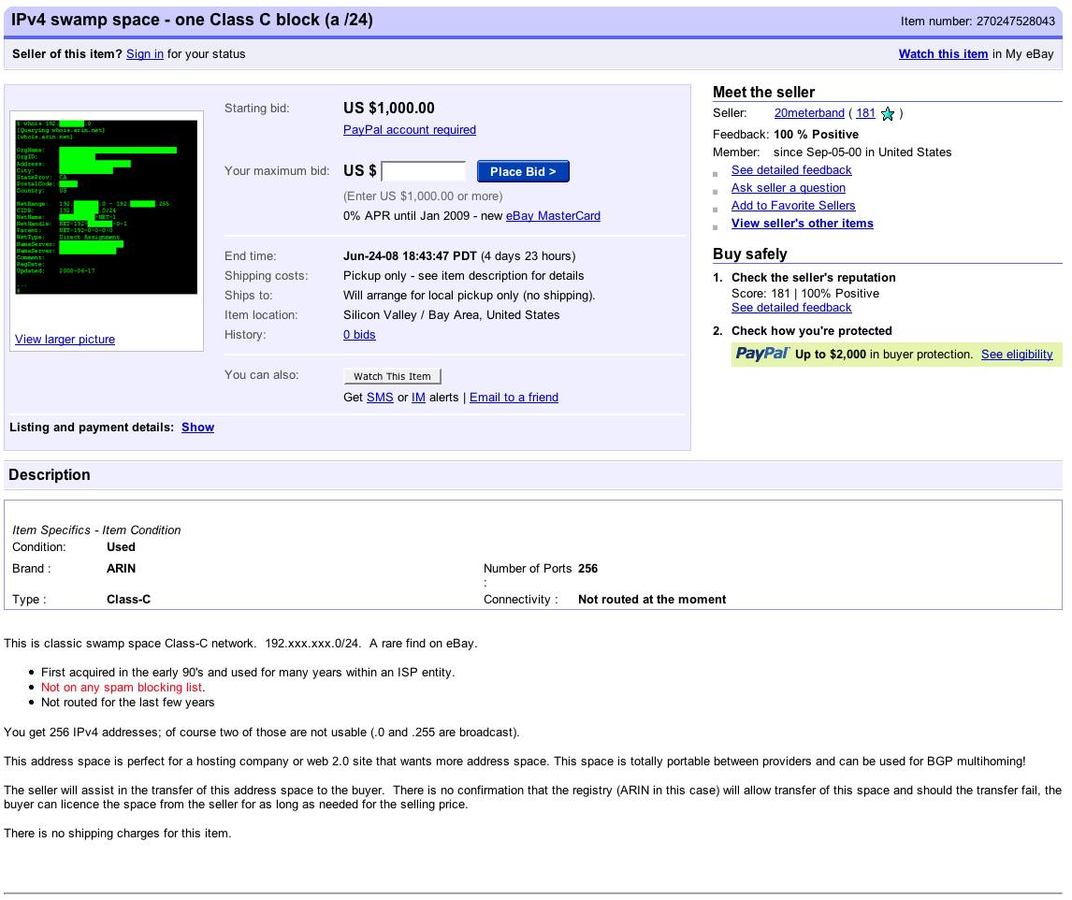

Slide 14
Where are we?
IPv4 free pools will be exhausted well before IPv6 transition is complete
5 to 10 years
ISPs will continue to need IPv4 after 2011
Where will they get it?
Options for RIRs
Reclamation/redistribution of legacy space
Facilitation and encouragement of transfer
Do nothing?

Slide 15
Thanks
pwilson@apnic.net

